Slide 1
Machine Learning II
Day 9
Deep Learning
Ayham Zaitouny, Leonardo Portes, and Debora Correa
Research Fellows
ARC Centre for Transforming Maintenance through Data Science (UWA)
ayham.zaitouny@uwa.edu.au
leonardo.portesdossantos@uwa.edu.au

Slide 2


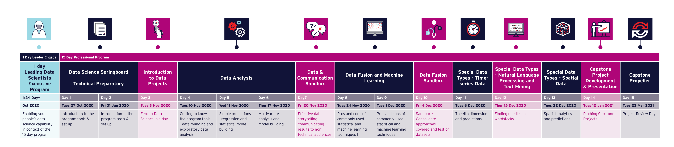

Delivering Data Science to Resources & Energy
Virtual Leader Day and Professional Programs 2020 Perth and Brisbane
Notes:
2

Slide 3

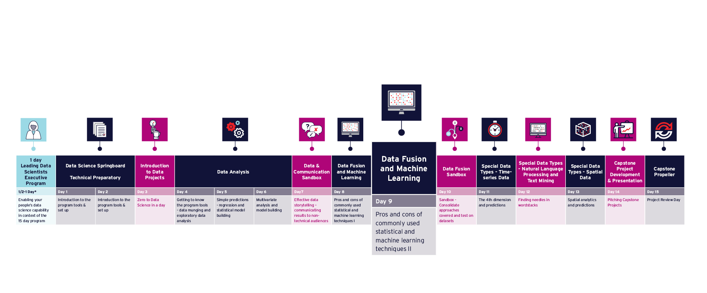
Program Timeline
Notes:
3

Slide 4
Plan of the day
AWST | AEST | Agenda
07:30 – 07:45 | 09:30 – 09:45 | Q&A, Issues & Announcements
07:45 – 09:15 | 09:45 – 11:15 | Fundamentals and Multilayer Perceptrons
09:15 – 09:30 | 11:15 – 11:30 | Morning tea
09:30 – 11:00 | 11:30 – 13:00 | Training Artificial Neural Networks
11:00 – 11:45 | 13:00 – 13:45 | Lunch
11:45 – 13:15 | 13:45 – 15:15 | Convolotuional Neural Networks
13:15 – 13:30 | 15:15 – 15:30 | Afternoon tea
13:30 – 14:45 | 15:30 – 16:45 | Recurrent Neural Networks
14:45 – 15:00 | 16:45 – 17:00 | Closeout

Slide 5

9
Introduce artificial neural networks and discuss architectures specially designed for images, sequence data and structured data.
Introduce the main concepts of deep learning and provide everyday industry examples.
Present the practical strategies to train neural networks.
Appreciate the powerful framework given by neural networks and deep learning techniques.
Recognise what types of data are required by such algorithms.
Have the general idea about how to train a neural network.
Know how to develop a project for classification/forecast with deep learning.

Slide 6
Day 09 Recap.
MSE
Precision
Recall
F1-score
Confusion matrix
Measures for
Imbalanced datasets
K fold cross validation
UNKOWN TARGET FUNCTION
(e.g. ideal formula to predict when to replace a component)
TEST DATA
STUDY THE
PROBLEM
Random
Forests
K-NN
SVM
TRAINING EXAMPLES ,…,
LEARNING
ALGORITHM
EVALUATE
APPLY
SOLUTION
(e.g. historical records of maintenance)
ANALYZE
ERRORS
Today: ANNs and deep learning.
Debora/Ayham/Leonardo (UWA)
Picture adapted from: Hands on Machine Learning with Scikit-Learn and TensorFlow, Cap 1.

Slide 7
Getting the Anaconda environment prepared
Go to GitHub /09-machinelearning and create the environment use: environment.yml
If you don’t have Anaconda: download it at https://www.anaconda.com/distribution/
Mac:
Open command prompt/terminal and type:
conda env create -f environment.yml
conda activate day09
Win:
Open command prompt/terminal and type:
conda env create -f environment.yml
activate day09
Or use Anaconda Interface (GUI)
Debora/Ayham/Leonardo (UWA)

Slide 8
Day 09 Fundamentals and Multilayer Perceptrons

Slide 9
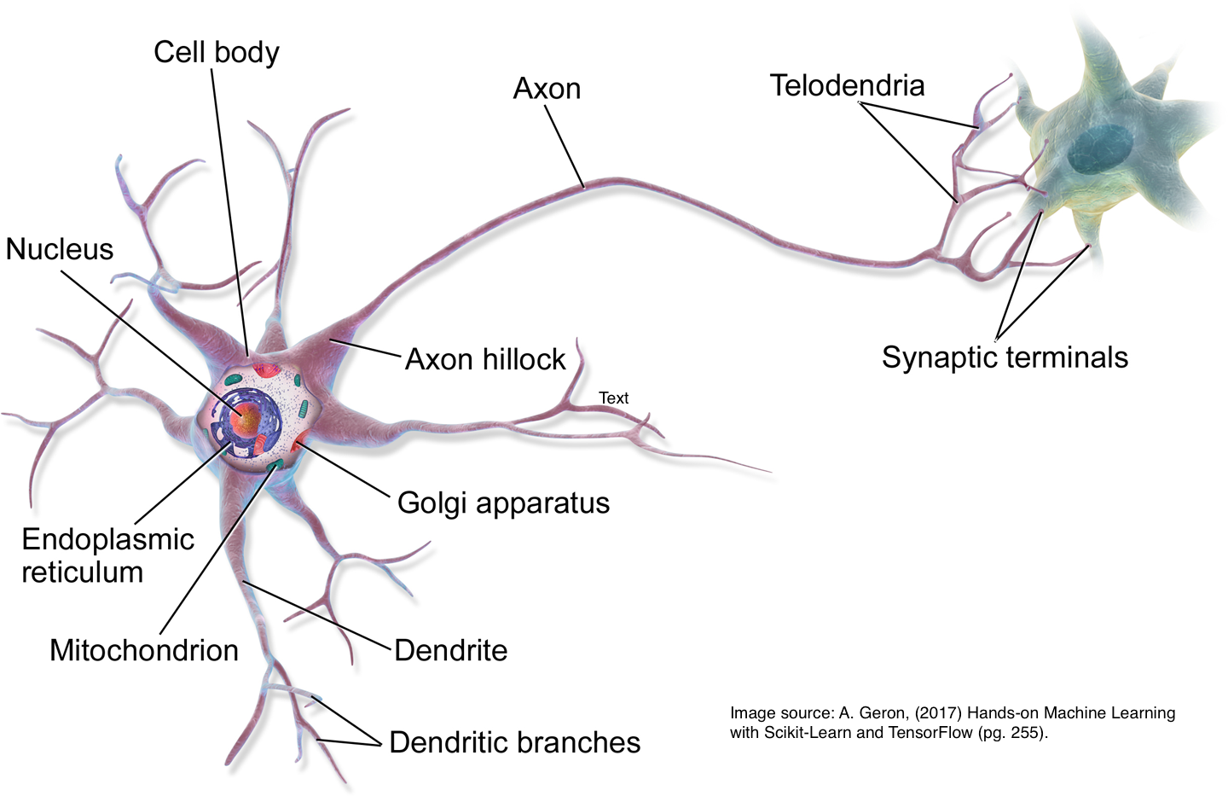
Day 09 ANNs Neuro-inspired computation
Artificial neural networks (ANNs): family of models with a gross inspiration from the brain.
Excellent pattern recognition models.
Excellent on unstructured data.
Biological neuron
Artificial neuron
Our brain: about 86 billion neurons¹.
Largest ANN: about million neurons².
1 https://www.nature.com/scitable/blog/brain-metrics/
2 https://phys.org/2018-06-ai-method-power-artificial-neural.html
Debora/Ayham/Leonardo (UWA)

Slide 10
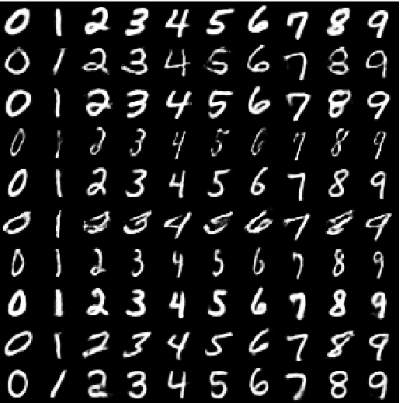
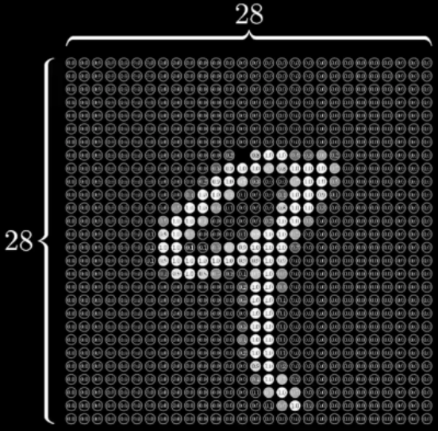
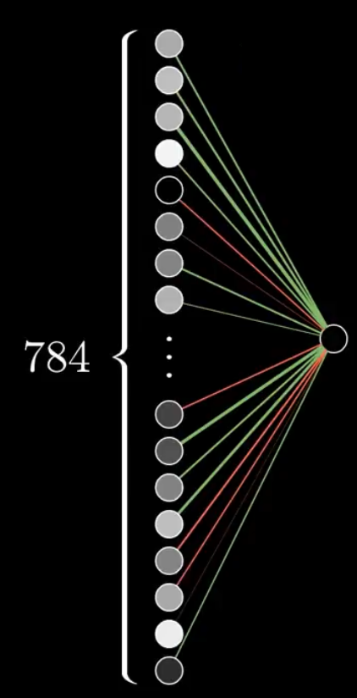

Day 09 ANNs Layers
data
instance
Input layer
Output
“Hidden Layers”
0.86
probability
of being a
9
?
28 x 28 = 784
Some figures from
https://www.youtube.com/watch?v=aircAruvnKk&list=PLZHQObOWTQDNU6R1_67000Dx_ZCJB-3pi
Debora/Ayham/Leonardo (UWA)

Slide 11
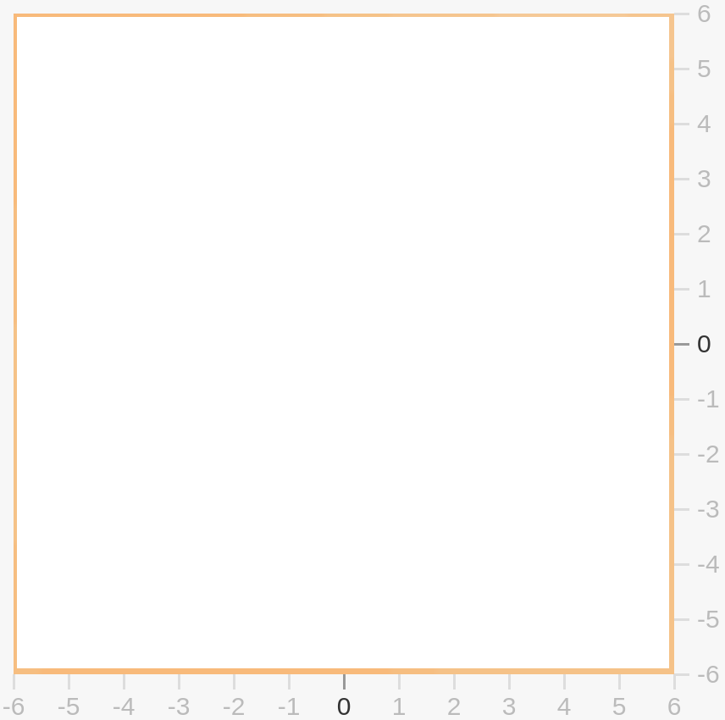

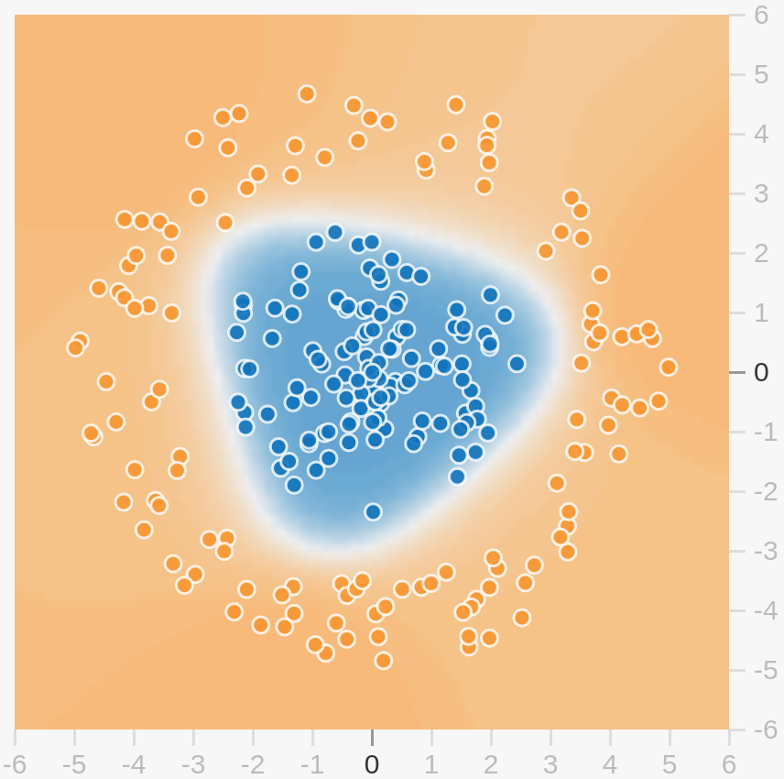
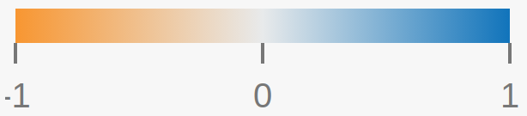
Day 09 ANNs Layers
data
Input layer
Output
“Hidden Layers”
x₁
?
Feature x₂
x₂
Feature x₁
Debora/Ayham/Leonardo (UWA)

Slide 12
Day 09 ANNs fundamental computational unity (“neuron”)
Input for our unity (“neuron”):
Gray scale levels of all pixels x_{i}, for i = 1, …, 784
With a given weight w_{i}
x^{unity} = w₁ x₁+w₂ x₂+ … + w₇₈₄ x₇₈₄
Looks like a linear regression!
Debora/Ayham/Leonardo (UWA)

Slide 13
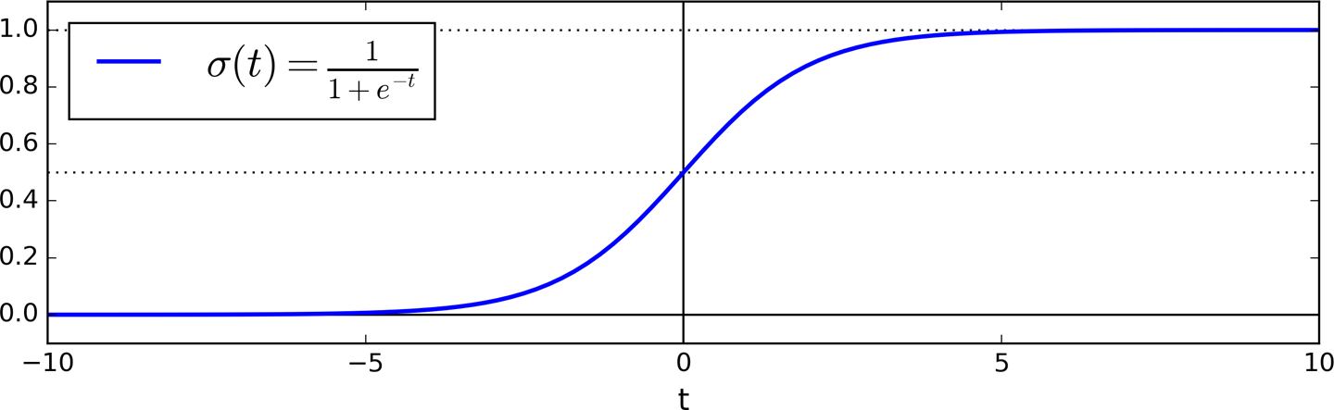
Day 09 ANNs fundamental computational unity (“neuron”)
Input for our unity (“neuron”):
Gray scale levels of all pixels x_{i}, for i = 1, …, 784
With a given weight w_{i}
State of our unity (it’s output):
A number (called activation)
0 < x^{unity}< 1
We need a transformation (activation function)
g = sigmoid
x^{unity} = g ( w₁ x₁+w₂ x₂+ … + w₇₈₄ x₇₈₄ )
Now it looks like a logistic regression!
Debora/Ayham/Leonardo (UWA)

Slide 14
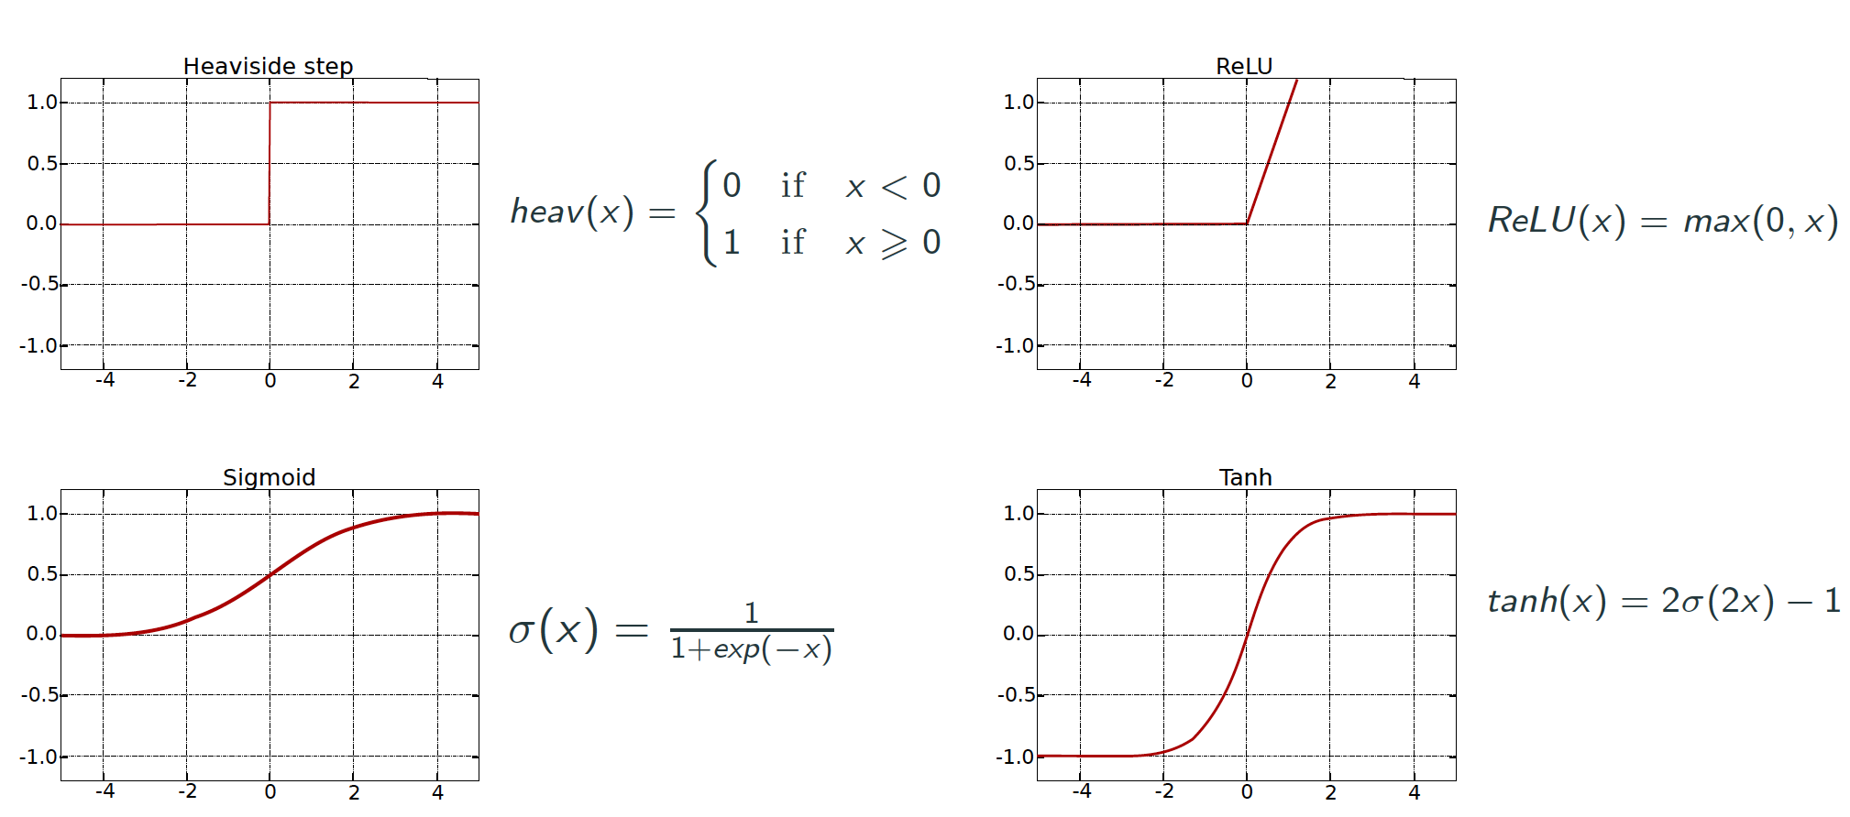
Day 09 Activation functions
Idea: Transformation the output of a neuron by a nonlinear function.
Normalization of the output (prevent outputs to explode due to the cascading effect).
This allows neural networks to learn complex patterns and deal with variability in the data.
Decision making at the output of a neuron.

Slide 15
Day 09 ANNs fundamental computational unity (“neuron”)
Input for our unity (“neuron”):
Gray scale levels of all pixels x_{i}, for i = 1, …, 784
With a given weight w_{i}
State of our unity (it’s output):
A number (called activation)
0 < x^{unity}< 1
We need a transformation (activation function)
Last ingredient:
Only activate meaningfully if weighted sum is greater than threshold b (bias!)
x^{unity} = g ( w₁ x₁+w₂ x₂+ … + w₇₈₄ x₇₈₄ + b )
x^{unity} = g ( w^{t} x+ b )
Debora/Ayham/Leonardo (UWA)
Bold letters → vectors!

Slide 16
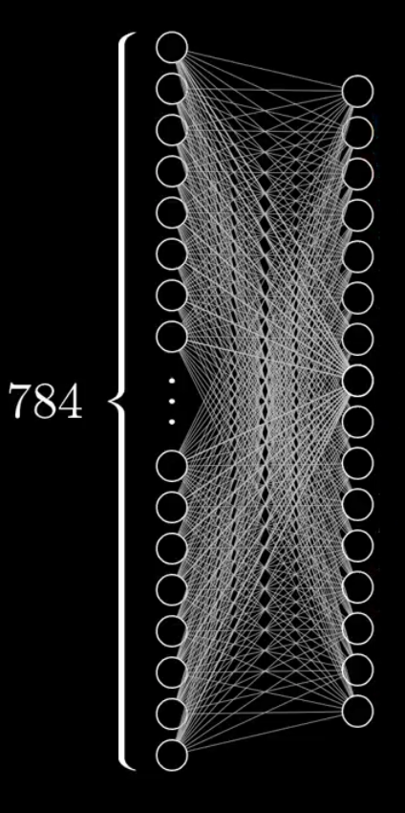
Day 09 ANNs connecting the unities
Layer 1
(input)
Layer 2 (hidden)
x^{unity k} = g ( w_{k,1} x₁+ w_{k,2} x_{k,2}+ … + w_{k,n} x_{k,n} + b_{k} )
W_{1,1} W_{1,2} … W_{1,n}
W_{2,1} W_{2,2} … W_{2,n}
W_{k,1} W_{k,2} … W_{k,n}
b₁
b₂
b_{n}
x₁
x₂
x_{n}
g
+
N = 784 (inputs)
k (lower case) unity (“neuron”) index
K (upper case) number of unities (“neurons”)
x^{(layer 2)} = g ( W x^{(layer 1)} + b )
Bold letters → vectors!
Bold upper case → matrices!

Slide 17
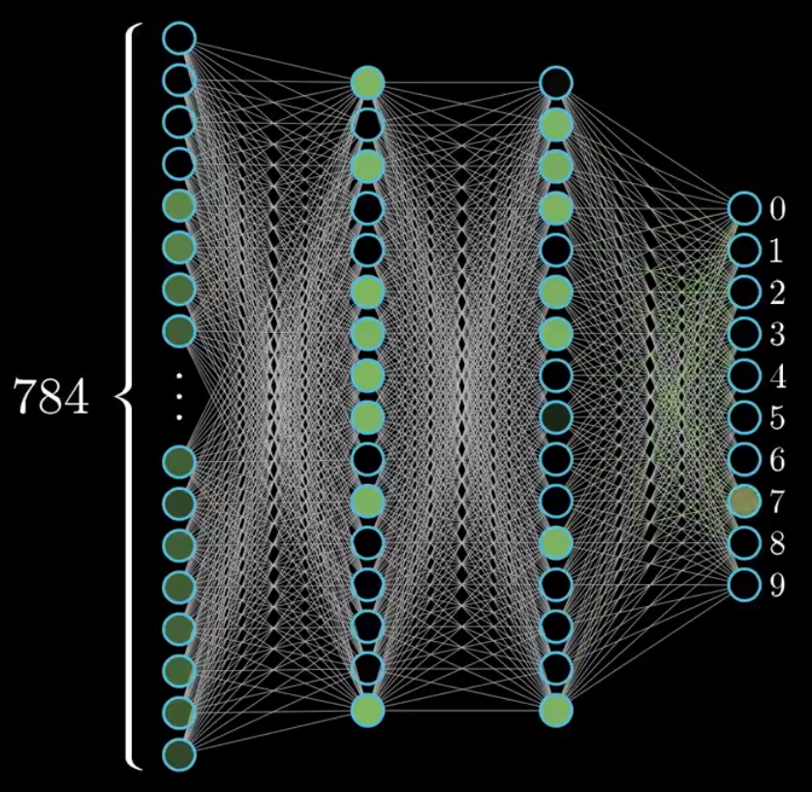

Day 09 ANNs Overview
Hidden layers
Input
layer
Output
layer
Instance
ANN
One hidden layer
Deep ANN
Two or more hidden layers
Learning what?
Weights and bias are the parameters to be learned
x^{(L+1)} = g ( w^{(L)} x^{(L)} + b^{(L)} )
Debora/Ayham/Leonardo (UWA)

Slide 18
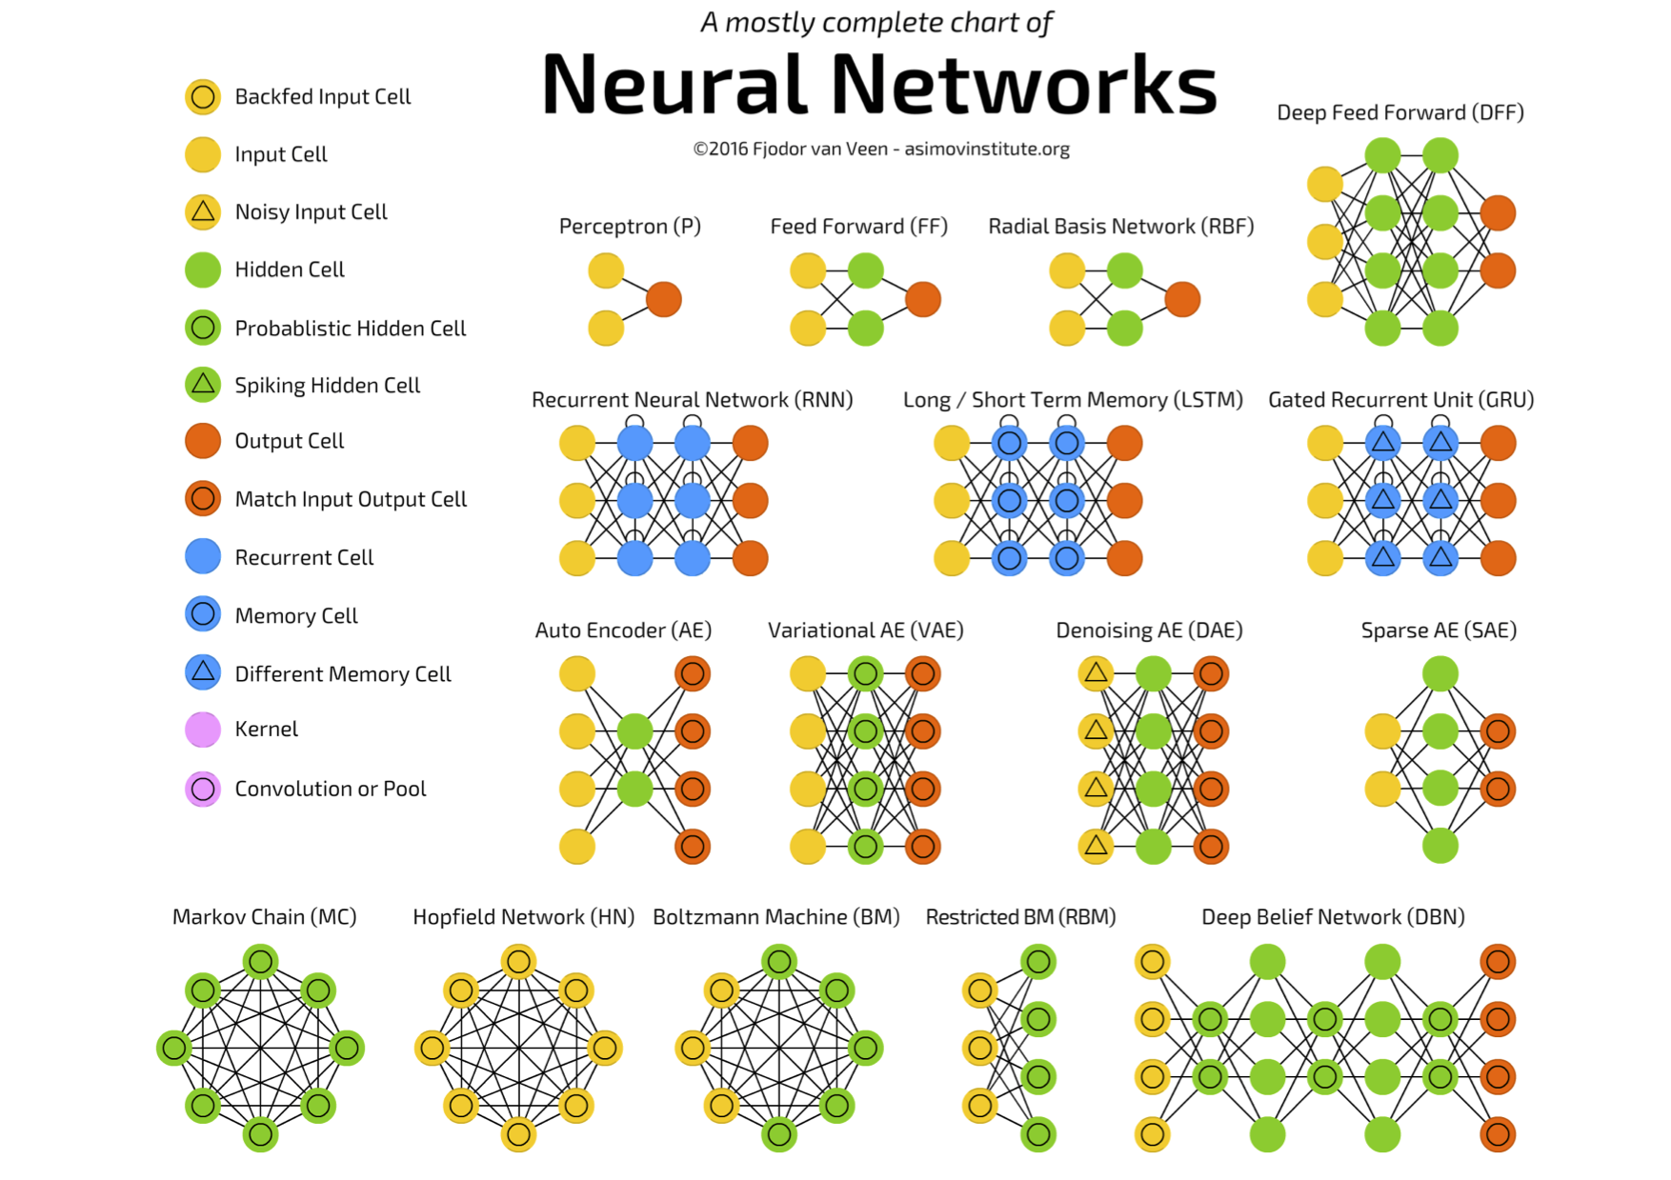
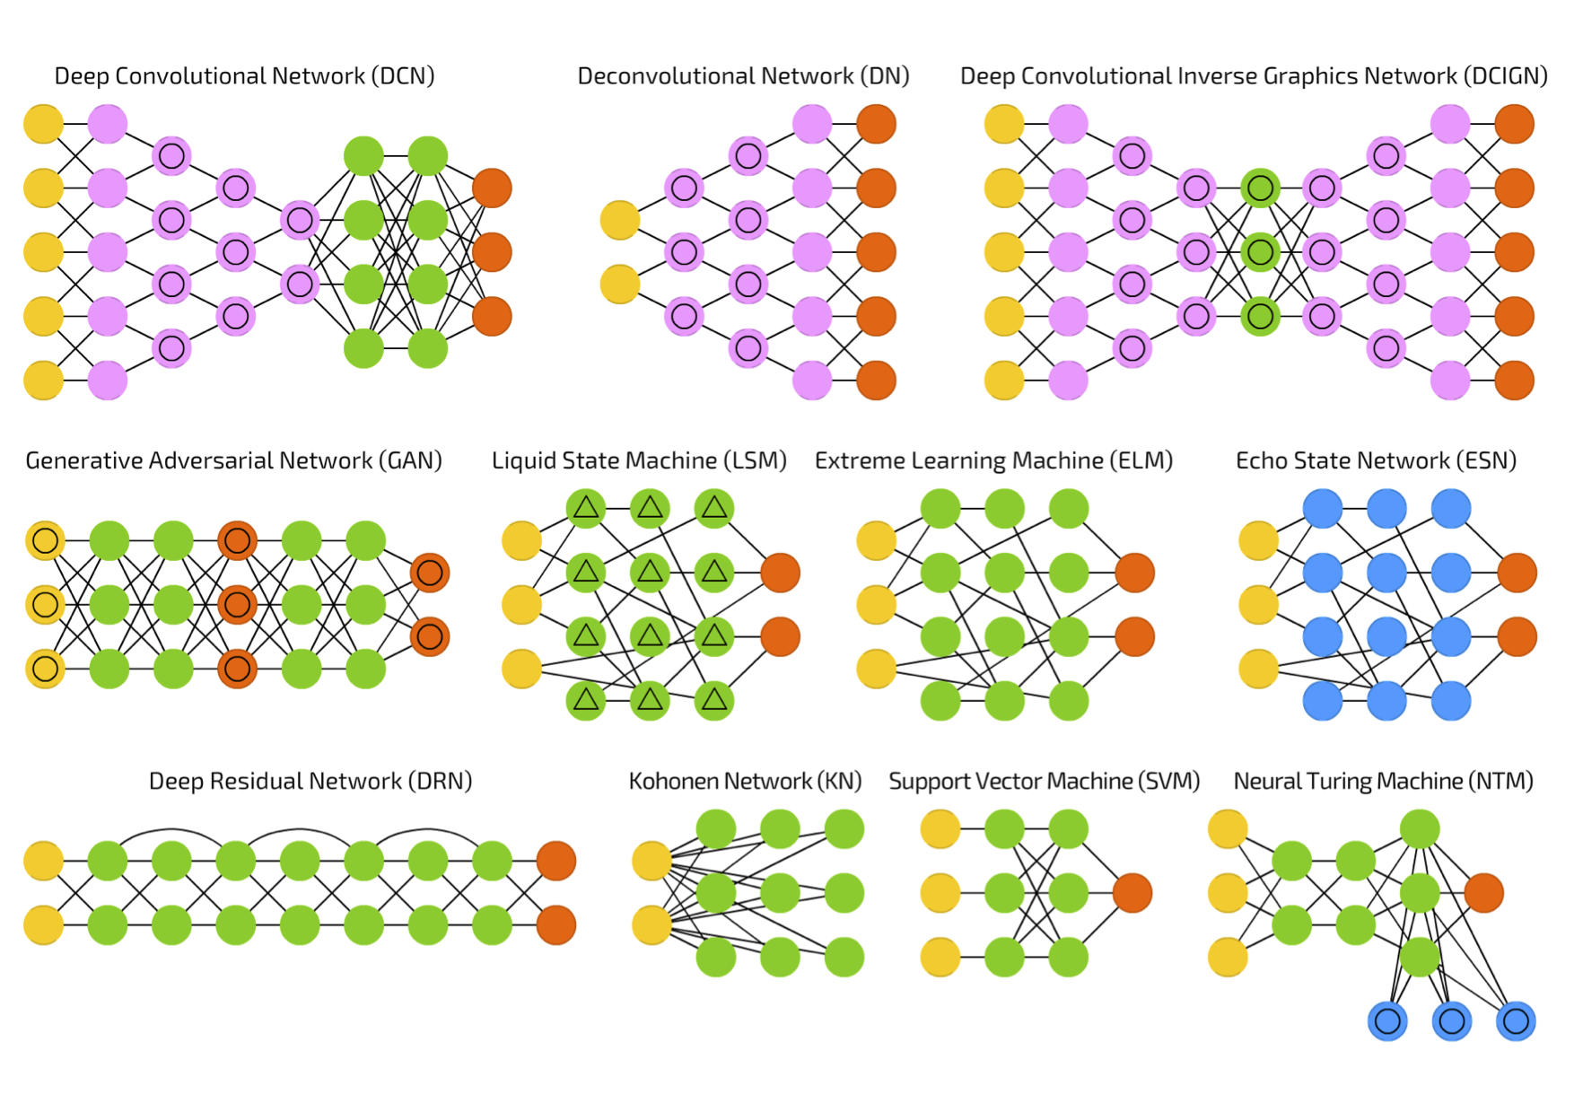
Day 09 ANNs and their flavours
ANNs are general function approximators and perform well when learning a complex mapping from the input to the output space.
What the network should capture in order to perform such mapping? What should be the input and the output?
Chart available at: https://towardsdatascience.com/the-mostly-complete-chart-of-neural-networks-explained-3fb6f2367464

Slide 19
Day 09 ANNs and applications
Structured data
Multilayer Perceptrons
Input: features, data matrix (samples x features)
Classification, regression.
Image data
Convolutional Neural Networks
Input: images
Classification (objects, face, scene, action, etc.)
Sequence data
Recurrent Neural Networks
Input: time series, audio, text
Classification, speech recognition, prediction.
Different types of data
Autoencoders
Input: original data representation
Dimensionality reduction, pre-training, data reconstruction.
Combination of different ANNs is also very common.

Slide 20
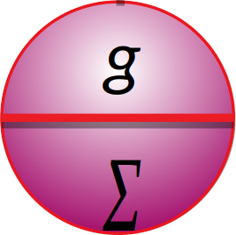
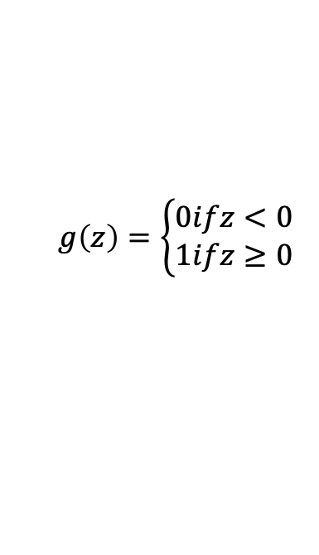
Day 09 Perceptron
Linear Threshold Units (LTUs) – Proposed by Frank Rosenblatt in 1957
$${\begin{aligned}h\end{aligned}}_{w}\left(x\right)=g\left({b+w}_{1}x_{1}+w_{2}x_{2}\right)=g\left(w^{t}.x+b\right)$$
$$g\left(z\right)=\left\{\begin{aligned}0ifz<0 \\ 1ifz≥0\end{aligned}\right.$$
output
g
LTU
$$Σ$$
The weights and bias are the parameters to be learned
Single LTU: simple linear binary classification
bias
b
1
w₁
w₂
weights
input layer
x₁
x₂
Notes:
20

Slide 21

Day 09 Perceptron (Cont.)
The perceptron can do multiclass classification
outputs
Perceptron learning rule (weight update)
g
g
g
LTUs
$$w_{ij}^{t+1}=w_{ij}^{t}+η\left({\hat{y}}_{j}−y_{j}\right)x_{i}$$
$$Σ$$
$$Σ$$
$$Σ$$
learning rate
1
x₁
x₂
If the classes are linearly separable, Perceptron will converge to a solution:
Perceptron convergence theorem
Debora/Ayham/Leonardo (UWA)
Source: Hands on Machine Learning with Scikit-Learn and TensorFlow, Cap. 10.

Slide 22
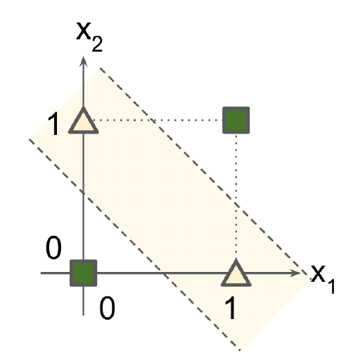
Day 09 From Perceptrons to Multilayer Perceptrons (MLPs)
MultiLayer Perceptron
XOR classification problem
g
output layer
$$Σ$$
1
g
g
hidden layer
$$Σ$$
$$Σ$$
1
x₁
x₂
input layer
Perceptron can not solve this!
Source: Hands on Machine Learning with Scikit-Learn and TensorFlow, Cap. 10.

Slide 23
Day 09 Multilayer Perceptrons
Used for the predictions.
For regression, linear activationfunctions can be used, or no activation function at all
g
g
g
output layer
$$Σ$$
$$Σ$$
$$Σ$$
g
g
g
g
1
hidden layer
$$Σ$$
$$Σ$$
$$Σ$$
$$Σ$$
Compute complex function by cascading simpler functions
1
input layer
x₁
x₂
Provides input data to the network
Deep Learning: when an ANN has two or more hidden layers.
Source: Hands on Machine Learning with Scikit-Learn and TensorFlow, Cap. 10.
Notes:
23

Slide 24
Day 09 Practice
Interactive Google platform for playing with ANNs
playground.tensorflow.org
Let’s create simple feedforward ANNs and see some effects of training in real time. ☺
Debora/Ayham/Leonardo (UWA)

Slide 25
Day 09 Practice 1/3
Before running the playground app
1) Visual inspection of the data shows that the classes are linearly separable. To solve that classification problem, what are the minimum number of: (i) Hidden layers? (ii) “neurons”? Now, go to the app and test your answers! Call that minimal model by M1.
2) Using only the information displayed in the app, show evidence that the trained model (M1) is performing well.
3) With model M1, try using only one cell in the input layer (eg, only x₁). Is that model still good? What is the evidence for your answer?
4) Call Md the default model (2 hidden layers: the first one with 4 “neurons” and the second with 2 “neurons”). How the performance of Md compares to M1 in question 2 and 3?
5) If you include noise (eg, level 20), is there any difference in performance between M1 and Md, for both 1 and 2 input cells?
DATA
Debora/Ayham/Leonardo (UWA)

Slide 26
Day 09 Practice 2/3
Start with the default model Md (2 hidden layers: the first one with 4 “neurons” and the second with 2 “neurons”)
1) Do you need “deep learning” to solve that classification problem? Explore that by changing the number of layers.
2) Train the ANN with only one hidden layer. Can you see any “neuron” in that layer doing “nothing”, or providing redundant information? Maybe you could remove it. If so, what happens with the model performance?
Consider these two models for questions 3 and 4:
(i) Hidden layer1 with 4 neurons and hidden layer 2 with 1 neuron.
(ii) Only one hidden layer with 4 neurons.
3) Which model is more complex (more degrees of freedom)?
4) Train both models. Which one performs better?
5) Could you train a successful model with just one neuron and one hidden layer? Explore the data structure (by visual inspection) and test if some features could help you.
DATA
Debora/Ayham/Leonardo (UWA)

Slide 27
Day 09 Practice 3/3
DATA
Try to solve this classification problem by exploring different:
Configurations of hidden layers
Number of neurons
Combinations of input features
Try to use the information provided by the test loss curve and training loss curve to guide your search (hint: last week, you learned how to use them to infer over/under fitting issues).
What is the simplest configuration you were able to find that solve that problem?
Debora/Ayham/Leonardo (UWA)

Slide 28
Suggested activities (homework)
The next two slides contain exercises for you to study at home. If possible, try to discuss them with your colleagues.
Debora/Ayham/Leonardo (UWA)

Slide 29
Day 09 Suggested activity (homework) 1/2
Part 1: No hidden layers
Select the third dataset.
Train the network using X₁ and X₂.
Select the first dataset.
Do the same: train the network using X₁ and X₂. What happened?
Explore the data structure. It has circular characteristics.
Include the square values of the features, X₁² and X₂², and train the network again. What happened?
Check if these new features can do a good job in the second and fourth datasets.
Explore the data structure of the second dataset. What combination of feature can we use?
Try to use only X₁ and X₂ with a nonlinear activation function.
Include a product of the features, X₁X₂ and do the training again.
Check if you get any good classification performance on the fourth dataset.
Debora/Ayham/Leonardo (UWA)

Slide 30
Day 09 Suggested activity (homework) 2/2
Part 2: Adding hidden layers
Include one hidden layer with one neuron, use only features X₁ and X₂.
Select the second dataset. Do the training using a linear activation function and with a sigmoid or tanh activation function.
Include one neuron in the hidden layer. Do step a) again.
Keep the nonlinear activation function and include one more hidden layers. Does it improve the performance? Does it take long to train?
Repeat some of these steps for a few times to see the effect of the random initialization of the weights.
Select the first dataset.
Do the training using one hidden layer with two neurons (you can use the sigmoid activation function).
Now, include one more neuron in the hidden layer. What happened?
Explore different configurations of hidden layers, number of hidden neuros and activation functions on the datasets.
Debora/Ayham/Leonardo (UWA)

Slide 31
Day 09 Training ANNs

Slide 32
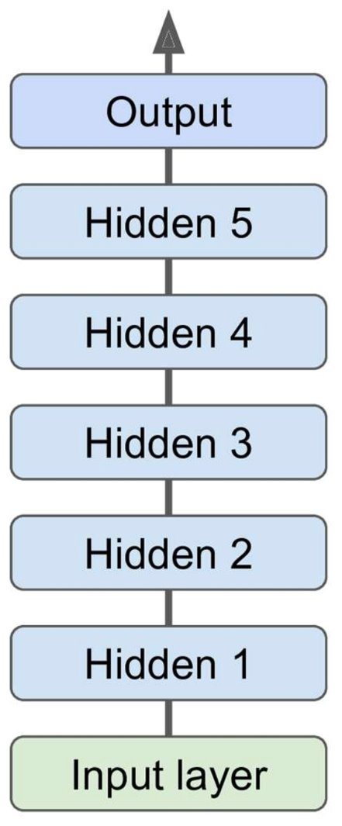
Multi-layer Perceptrons
*Deep neural network (DNN), when an ANN has two or more hidden layers
One output layer
One or more hidden layers
One input layer
Débora/Ayham (UWA)

Slide 33
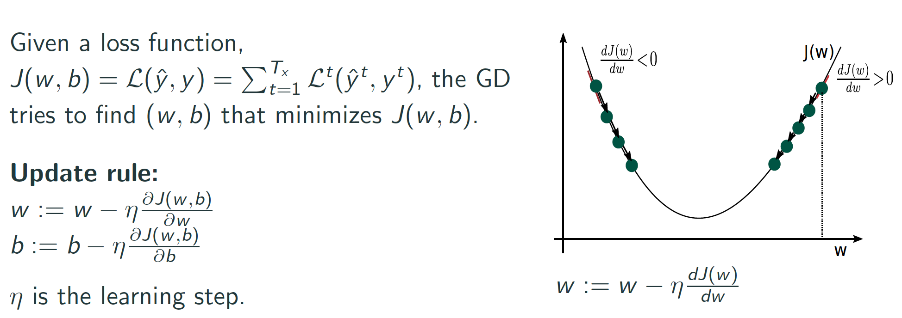
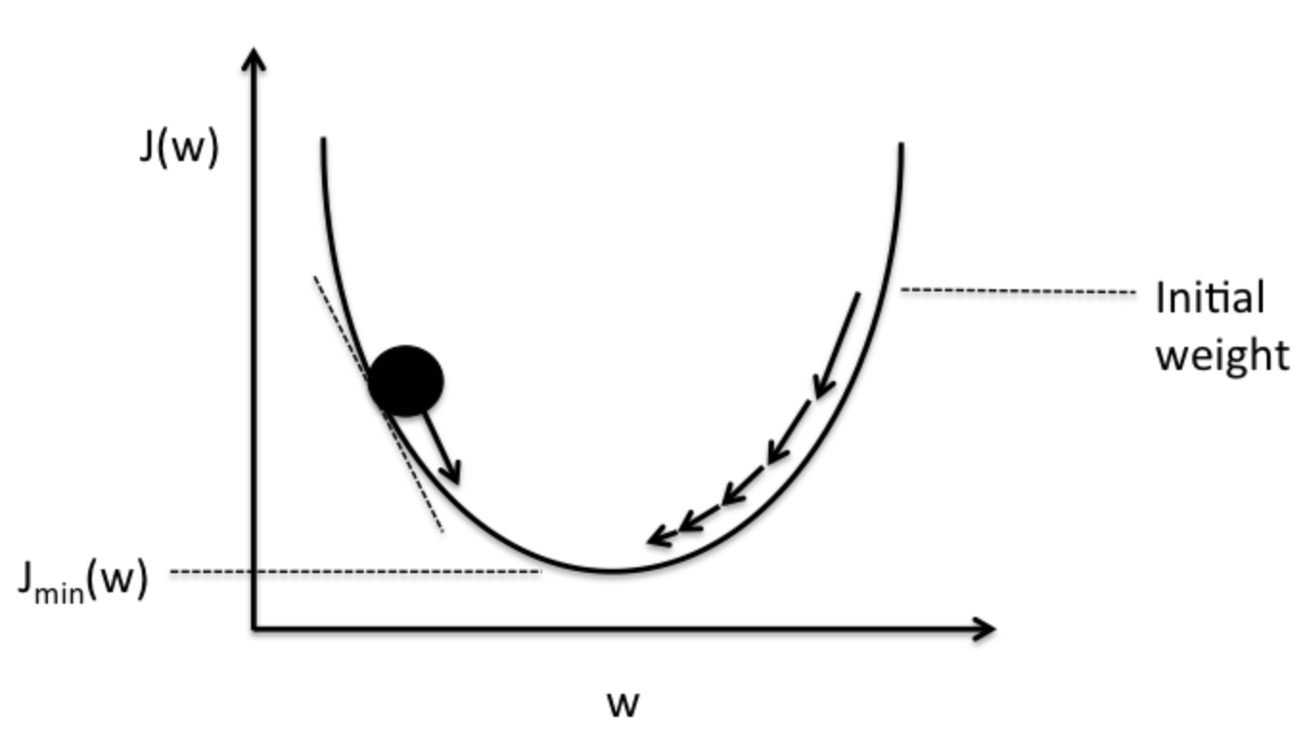
Day 09 Gradient-based learning algorithm
Gradient Descent:
Iterative optimization approach.
Idea: tweak parameters of the model to minimize a loss function over the training set.
It computes the error derivatives with respect to each parameter of the model.
Increase weight
Decrease weight
https://medium.com/datathings/neural-networks-and-backpropagation-explained-in-a-simple-way-f540a3611f5e

Slide 34
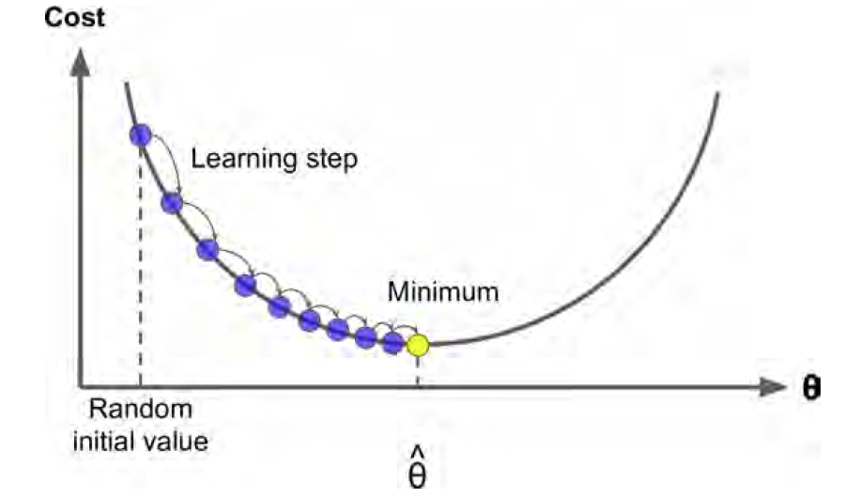
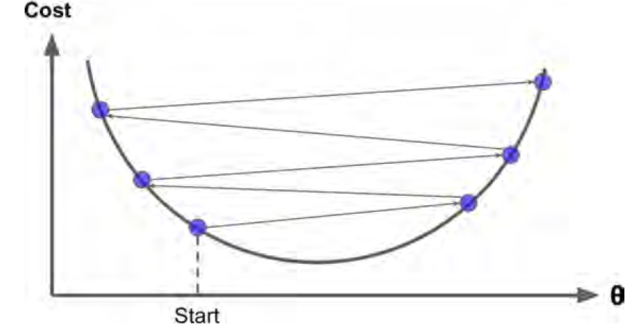
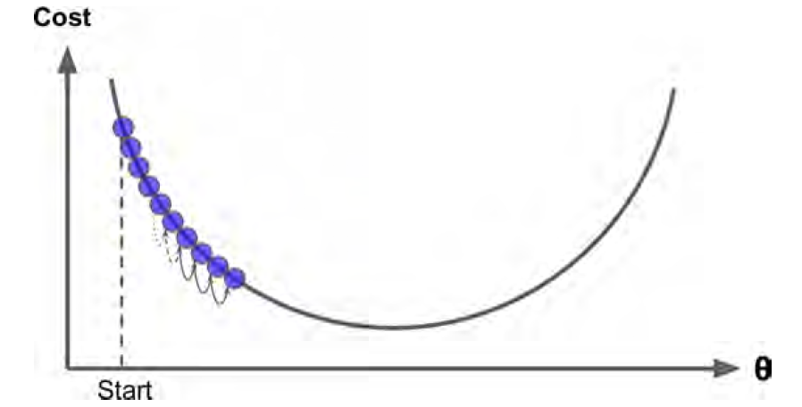
Day 09 Gradient-based learning algorithm
Gradient Descent:
Iterative optimization approach.
Idea: tweak parameters of the model to minimize a loss function over the training set.
It computes the error derivatives with respect to each parameter of the model.
Source: Hands on Machine Learning with Scikit-Learn and TensorFlow, Cap. 4

Slide 35

Stochastic Gradient Descent
Gradient Descend (GD) uses the whole training set to compute the errors (gradients) at every step.
GD is slow for training large data sets.
SGD picks random instances of the training set at every step and computes the errors based only on that instances.
Less regular than GD, but it is feasible for large data sets.
Débora/Ayham (UWA)

Slide 36
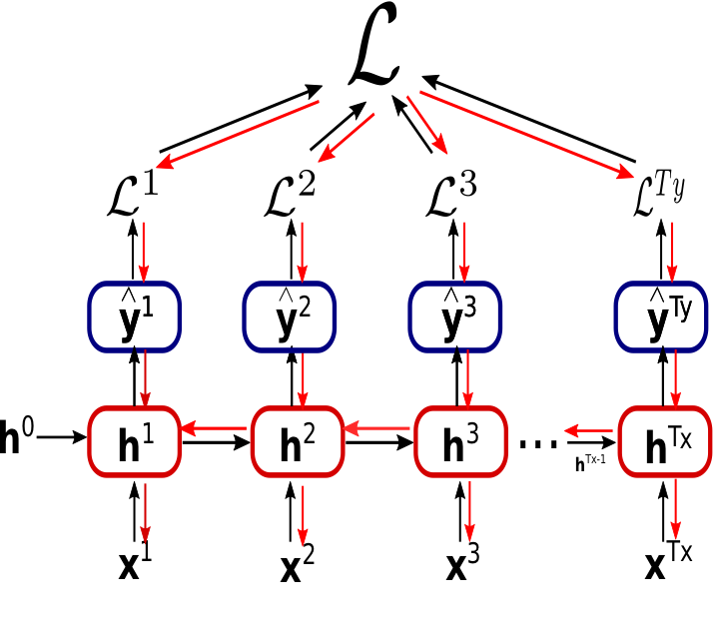
Back Propagation Training Algorithm
For each instance fed to the network, the backpropagation algorithm first makes a prediction (forward pass)
Then measures the error and goes through each layer in reverse to measure the contribution from each neuron (backward pass)
Finally, the algorithm tunes the neuron weights to reduce the error (gradient descent step)
Débora/Ayham (UWA)

Slide 37
Back Propagation Training Algorithm
For each instance fed to the network, the backpropagation algorithm first makes a prediction (forward pass)
Then measures the error and goes through each layer in reverse to measure the contribution from each neuron (backward pass)
Finally, the algorithm tunes the neuron weights to reduce the error (gradient descent step)
Débora/Ayham (UWA)

Slide 38
Back Propagation Training Algorithm
For each instance fed to the network, the backpropagation algorithm first makes a prediction (forward pass)
Then measures the error and goes through each layer in reverse to measure the contribution from each neuron (backward pass)
Finally, the algorithm tunes the neuron weights to reduce the error (gradient descent step)
Débora/Ayham (UWA)

Slide 39
MLPs Hyperparameters
Challenges in training MLPs – Many hypermeters to tune:
Débora/Ayham (UWA)

Slide 40
MLPs Hyperparameters
Challenges in training MLPs – Many hypermeters to tune:
Number of hidden layers: for many problems, one or two hidden layers are sufficient. For more complex problems, we can gradually increase the number of hidden layers until we start overfitting the training set. Very complex problems (large image classification or speech recognition), require dozens of layers and they need huge amount of training set. (Hierarchical Structure)
Number of neurons per hidden layer: number of neurons in the input and output layers is determined by your task. A common practice is to size the number of neurons in hidden layers to form a funnel (fewer and fewer neurons at each higher layer). A simpler approach is to pick a model with more layers and neurons than actually need, then use regularization (e.g. dropout) to prevent overfitting.
Activation functions: ReLU in hidden layers is a bit faster to compute than other activation functions, and Gradient Descent does not get stuck as much on local minima. For output layer: Softmax is generally a good choice for classification, for regression you can use no activation function at all.
Weight initialization logic
Débora/Ayham (UWA)

Slide 41
MLPs Hyperparameters
Challenges in training MLPs – Many hypermeters to tune:
Number of hidden layers: for many problems, one or two hidden layers are sufficient. For more complex problems, we can gradually increase the number of hidden layers until we start overfitting the training set. Very complex problems (large image classification or speech recognition), require dozens of layers and they need huge amount of training set. (Hierarchical Structure)
Number of neurons per hidden layer: number of neurons in the input and output layers is determined by your task. A common practice is to size the number of neurons in hidden layers to form a funnel (fewer and fewer neurons at each higher layer). A simpler approach is to pick a model with more layers and neurons than actually need, then use regularization (e.g. dropout) to prevent overfitting.
Activation functions: ReLU in hidden layers is a bit faster to compute than other activation functions, and Gradient Descent does not get stuck as much on local minima. For output layer: Softmax is generally a good choice for classification, for regression you can use no activation function at all.
Weight initialization logic
Débora/Ayham (UWA)

Slide 42
MLPs Hyperparameters
Challenges in training MLPs – Many hypermeters to tune:
Number of hidden layers: for many problems, one or two hidden layers are sufficient. For more complex problems, we can gradually increase the number of hidden layers until we start overfitting the training set. Very complex problems (large image classification or speech recognition), require dozens of layers and they need huge amount of training set. (Hierarchical Structure)
Number of neurons per hidden layer: number of neurons in the input and output layers is determined by your task. A common practice is to size the number of neurons in hidden layers to form a funnel (fewer and fewer neurons at each higher layer). A simpler approach is to pick a model with more layers and neurons than actually need, then use regularization (e.g. dropout) to prevent overfitting.
Activation functions: ReLU in hidden layers is a bit faster to compute than other activation functions, and Gradient Descent does not get stuck as much on local minima. For output layer: Softmax is generally a good choice for classification, for regression you can use no activation function at all.
Weight initialization logic
Débora/Ayham (UWA)

Slide 43
MLPs Hyperparameters
Challenges in training MLPs – Many hypermeters to tune:
Number of hidden layers: for many problems, one or two hidden layers are sufficient. For more complex problems, we can gradually increase the number of hidden layers until we start overfitting the training set. Very complex problems (large image classification or speech recognition), require dozens of layers and they need huge amount of training set. (Hierarchical Structure)
Number of neurons per hidden layer: number of neurons in the input and output layers is determined by your task. A common practice is to size the number of neurons in hidden layers to form a funnel (fewer and fewer neurons at each higher layer). A simpler approach is to pick a model with more layers and neurons than actually need, then use regularization (e.g. dropout) to prevent overfitting.
Activation functions: ReLU in hidden layers is a bit faster to compute than other activation functions, and Gradient Descent does not get stuck as much on local minima. For output layer: Softmax is generally a good choice for classification, for regression you can use no activation function at all.
Weight initialization logic
Débora/Ayham (UWA)

Slide 44
MLPs Hyperparameters
Challenges in training MLPs – Many hypermeters to tune:
Number of hidden layers: for many problems, one or two hidden layers are sufficient. For more complex problems, we can gradually increase the number of hidden layers until we start overfitting the training set. Very complex problems (large image classification or speech recognition), require dozens of layers and they need huge amount of training set. (Hierarchical Structure)
Number of neurons per hidden layer: number of neurons in the input and output layers is determined by your task. A common practice is to size the number of neurons in hidden layers to form a funnel (fewer and fewer neurons at each higher layer). A simpler approach is to pick a model with more layers and neurons than actually need, then use regularization (e.g. dropout) to prevent overfitting.
Activation functions: ReLU in hidden layers is a bit faster to compute than other activation functions, and Gradient Descent does not get stuck as much on local minima. For output layer: Softmax is generally a good choice for classification, for regression you can use no activation function at all.
Weight initialization logic
* In theory, we could use cross-validation but it costs a lot of time and computations
Débora/Ayham (UWA)

Slide 45
Tools and strategies for training MLPs/DNN
Problems faced through training a DNN:
Débora/Ayham (UWA)

Slide 46
Tools and strategies for training MLPs/DNN
Problems faced through training a DNN:
Vanishing gradients problem (or the related, exploding gradients problem) that makes lower layers very hard to train: backpropagation works by going from the output layer to the input layer. The gets smaller and smaller as the algorithm progresses down, as a result the gradient descent update leaves the lower layer connection weights unchanged and training never converges to a good solution.
Training DNNs would be very slow with large networks
A DNN with many parameters would severely risk overfitting the training set
Débora/Ayham (UWA)

Slide 47
Tools and strategies for training MLPs/DNN
Problems faced through training a DNN:
Vanishing gradients problem (or the related, exploding gradients problem) that makes lower layers very hard to train: backpropagation works by going from the output layer to the input layer. The gets smaller and smaller as the algorithm progresses down, as a result the gradient descent update leaves the lower layer connection weights unchanged and training never converges to a good solution.
Training DNNs would be very slow with large networks
A DNN with many parameters would severely risk overfitting the training set
Popular strategies to solve vanishing/exploding gradients problem
Débora/Ayham (UWA)

Slide 48
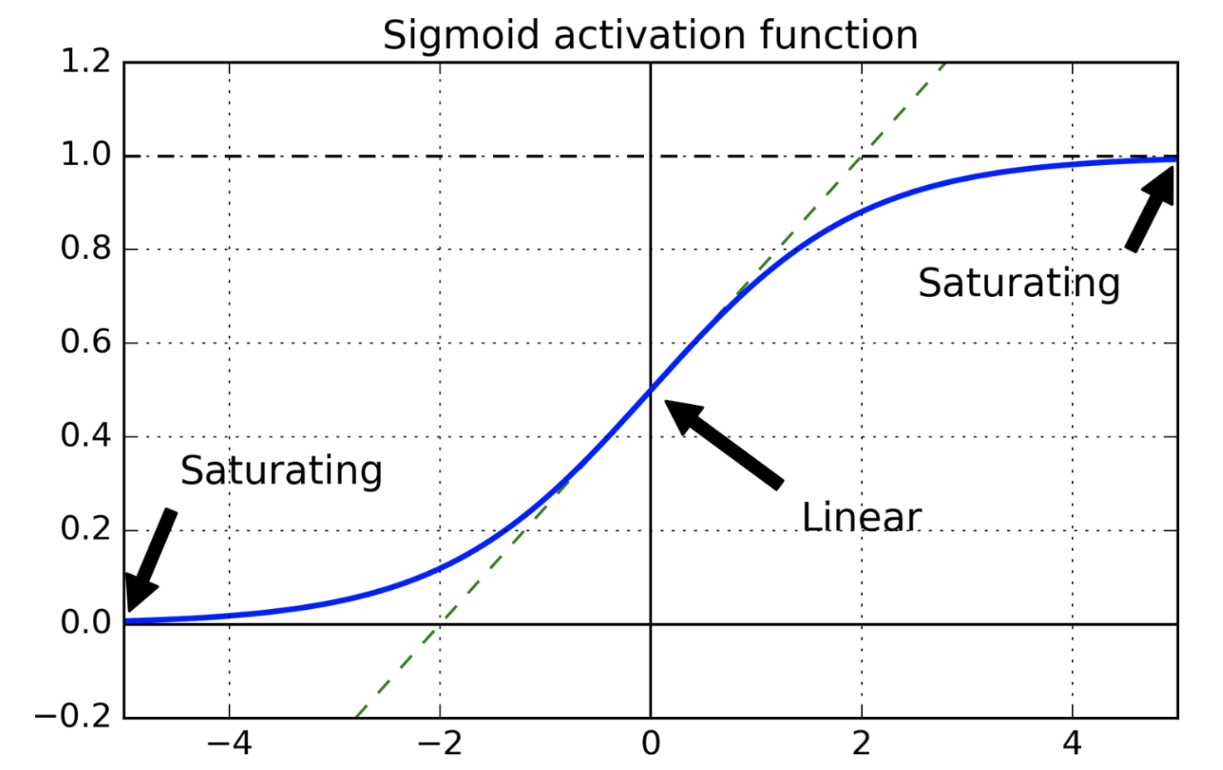
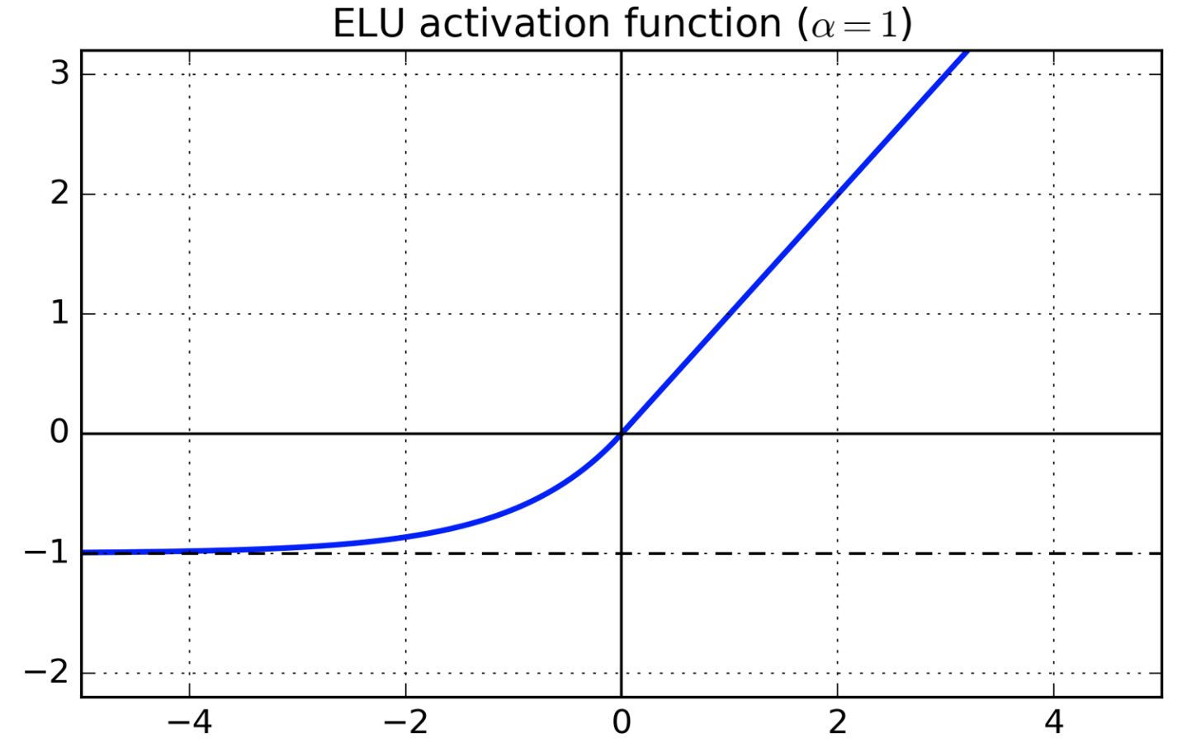
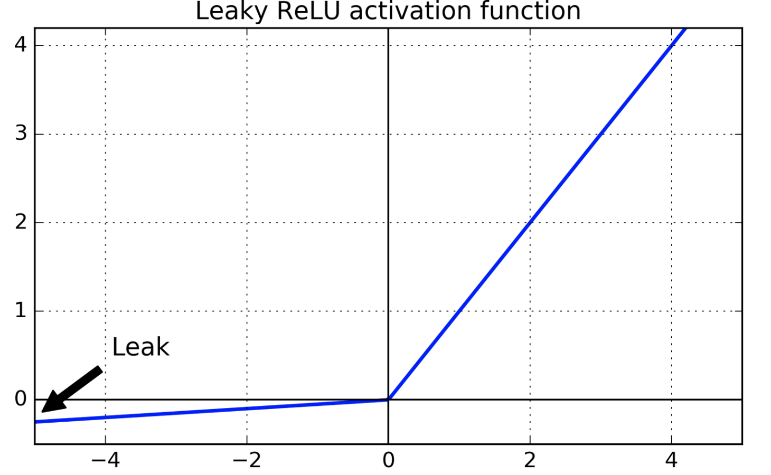
Tools and strategies for training MLPs/DNN
Strategies to solve vanishing/exploding gradients problems:
Input normalization (zero mean and unit std)
Xavier/Glorot weight initialization
Nonsaturating activation functions:
Exponential Linear Unit (ELU) Leaky ReLU
Batch Normalization:
Zero-centre and normalization of the inputs in each layer before activation function is computed
Gradient clipping:
Used for exploding gradients
Rescale gradients to prevent they exceed a maximum threshold
Débora/Ayham (UWA)

Slide 49
Tools and strategies for training MLPs/DNN
Problems faced through training a DNN:
Vanishing gradients problem (or the related, exploding gradients problem) that makes lower layers very hard to train: backpropagation works by going from the output layer to the input layer. The gets smaller and smaller as the algorithm progresses down, as a result the gradient descent update leaves the lower layer connection weights unchanged and training never converges to a good solution.
Training DNNs would be very slow with large networks
A DNN with many parameters would severely risk overfitting the training set
Popular strategies to solve vanishing/exploding gradients problem
Débora/Ayham (UWA)

Slide 50
Tools and strategies for training MLPs/DNN
Problems faced through training a DNN:
Vanishing gradients problem (or the related, exploding gradients problem) that makes lower layers very hard to train: backpropagation works by going from the output layer to the input layer. The gets smaller and smaller as the algorithm progresses down, as a result the gradient descent update leaves the lower layer connection weights unchanged and training never converges to a good solution.
Training DNNs would be very slow with large networks
A DNN with many parameters would severely risk overfitting the training set
Popular strategies to solve vanishing/exploding gradients problem
Faster optimizers that can speed up the training
Débora/Ayham (UWA)

Slide 51
Tools and strategies for training MLPs/DNN
Faster optimizers (variations of the Stochastic Gradient Descent):
Momentum optimization
Nesterov Accelerated Gradient
AdaGrad
RMSProp
Adam Optimization
Learning Rate Scheduling
Débora/Ayham (UWA)

Slide 52
Tools and strategies for training MLPs/DNN
Problems faced through training a DNN:
Vanishing gradients problem (or the related, exploding gradients problem) that makes lower layers very hard to train: backpropagation works by going from the output layer to the input layer. The gets smaller and smaller as the algorithm progresses down, as a result the gradient descent update leaves the lower layer connection weights unchanged and training never converges to a good solution.
Training DNNs would be very slow with large networks
A DNN with many parameters would severely risk overfitting the training set
Popular strategies to solve vanishing/exploding gradients problem
Faster optimizers that can speed up the training
Débora/Ayham (UWA)

Slide 53
Tools and strategies for training MLPs/DNN
Problems faced through training a DNN:
Vanishing gradients problem (or the related, exploding gradients problem) that makes lower layers very hard to train: backpropagation works by going from the output layer to the input layer. The gets smaller and smaller as the algorithm progresses down, as a result the gradient descent update leaves the lower layer connection weights unchanged and training never converges to a good solution.
Training DNNs would be very slow with large networks
A DNN with many parameters would severely risk overfitting the training set
Popular strategies to solve vanishing/exploding gradients problem
Faster optimizers that can speed up the training
Popular regularization techniques to avoid overfitting
Débora/Ayham (UWA)

Slide 54
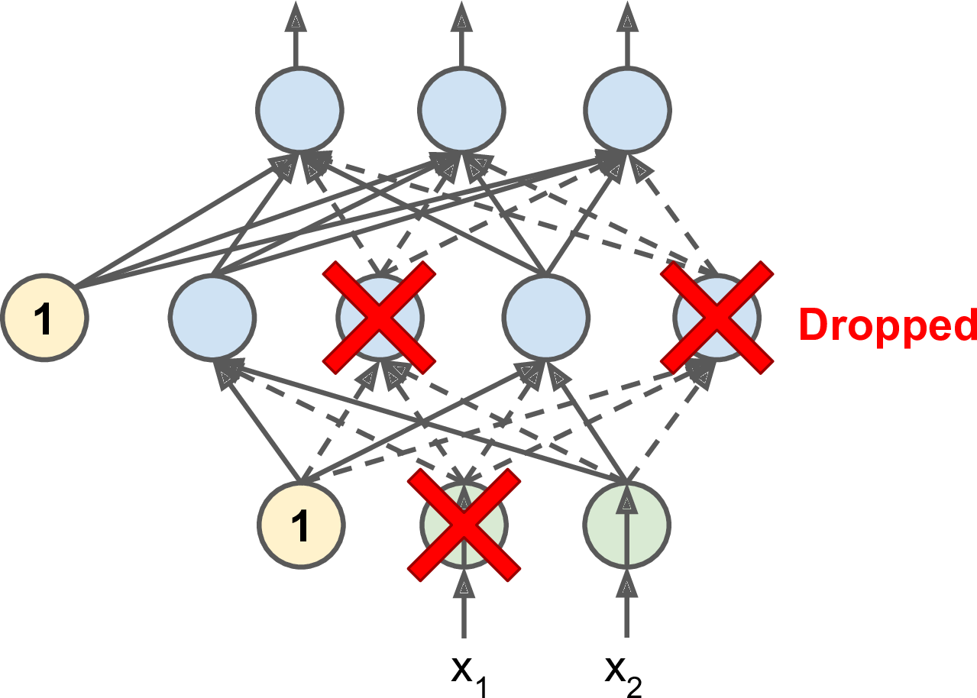
Tools and strategies for training MLPs/DNN
Avoid overfitting through regularization:
Early Stopping
L1 and L2 Regularization
Dropout
Max-norm Regularization
Data Augmentation
Débora/Ayham (UWA)

Slide 55
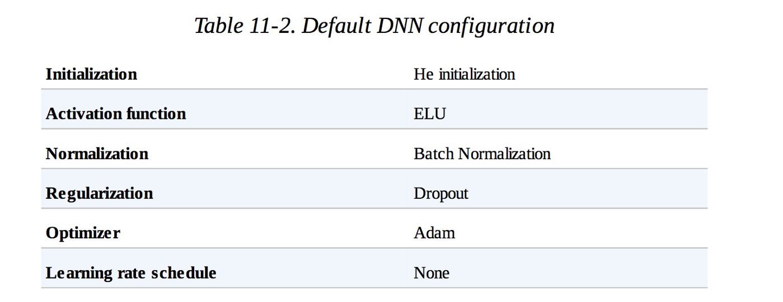
Tools and strategies for training MLPs/DNN
Avoid overfitting through regularization:
Early Stopping
L1 and L2 Regularization
Dropout
Max-norm Regularization
Data Augmentation
Débora/Ayham (UWA)

Slide 56
Day 09 Convolutional Neural Networks (CNNs)

Slide 57
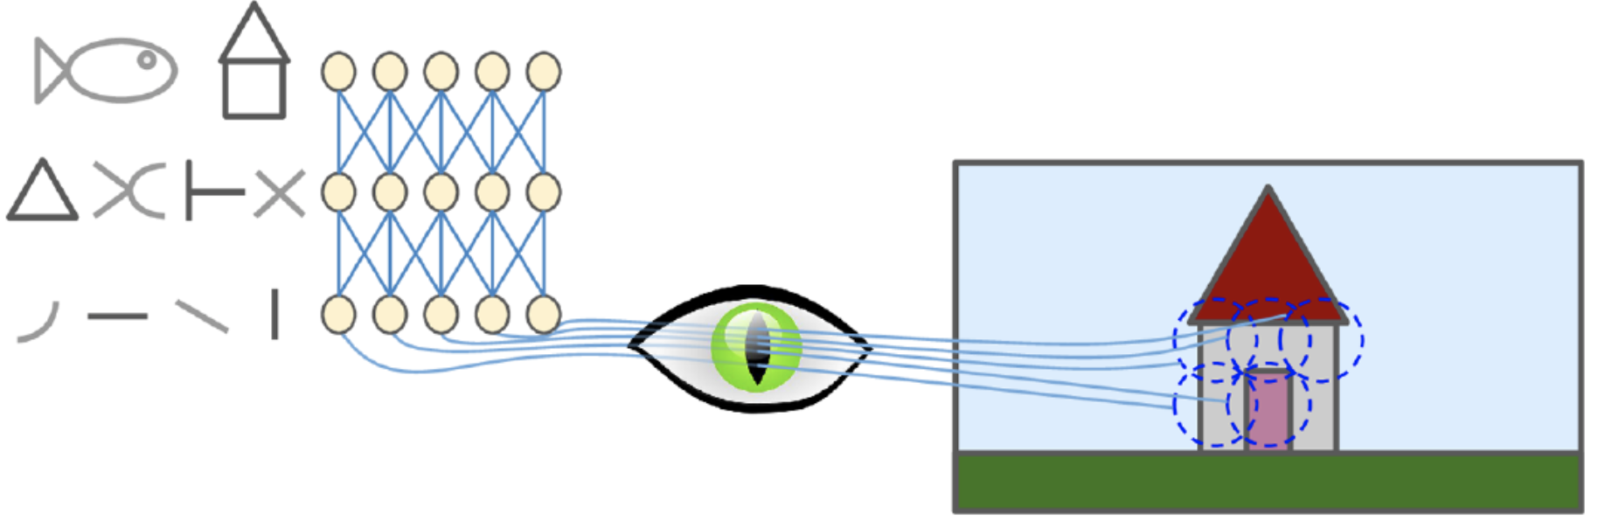
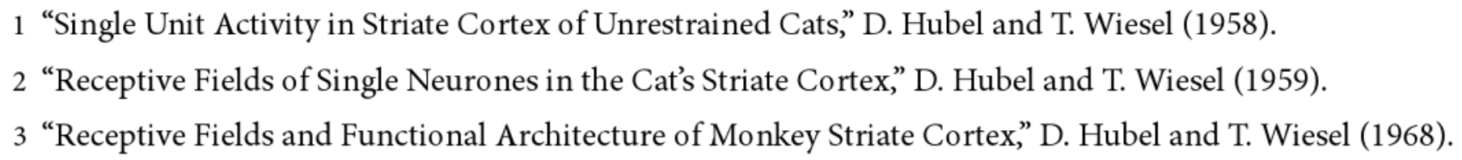
Day 09 CNN Motivation
Insights on the structure of the visual cortex^{1,2,3}
Neurons respond to a small local receptive field: they react to a visual stimuli placed in a small region of the visual field.
Their receptive fields can overlap, and the whole visual field arises from the combination of individual local fields.
Idea that higher-level neurons use the neighboring of lower-level neurons, forming more complex patterns by combining lower-level patterns.
Source: Hands on Machine Learning with Scikit-Learn and TensorFlow, Cap. 13.

Slide 58
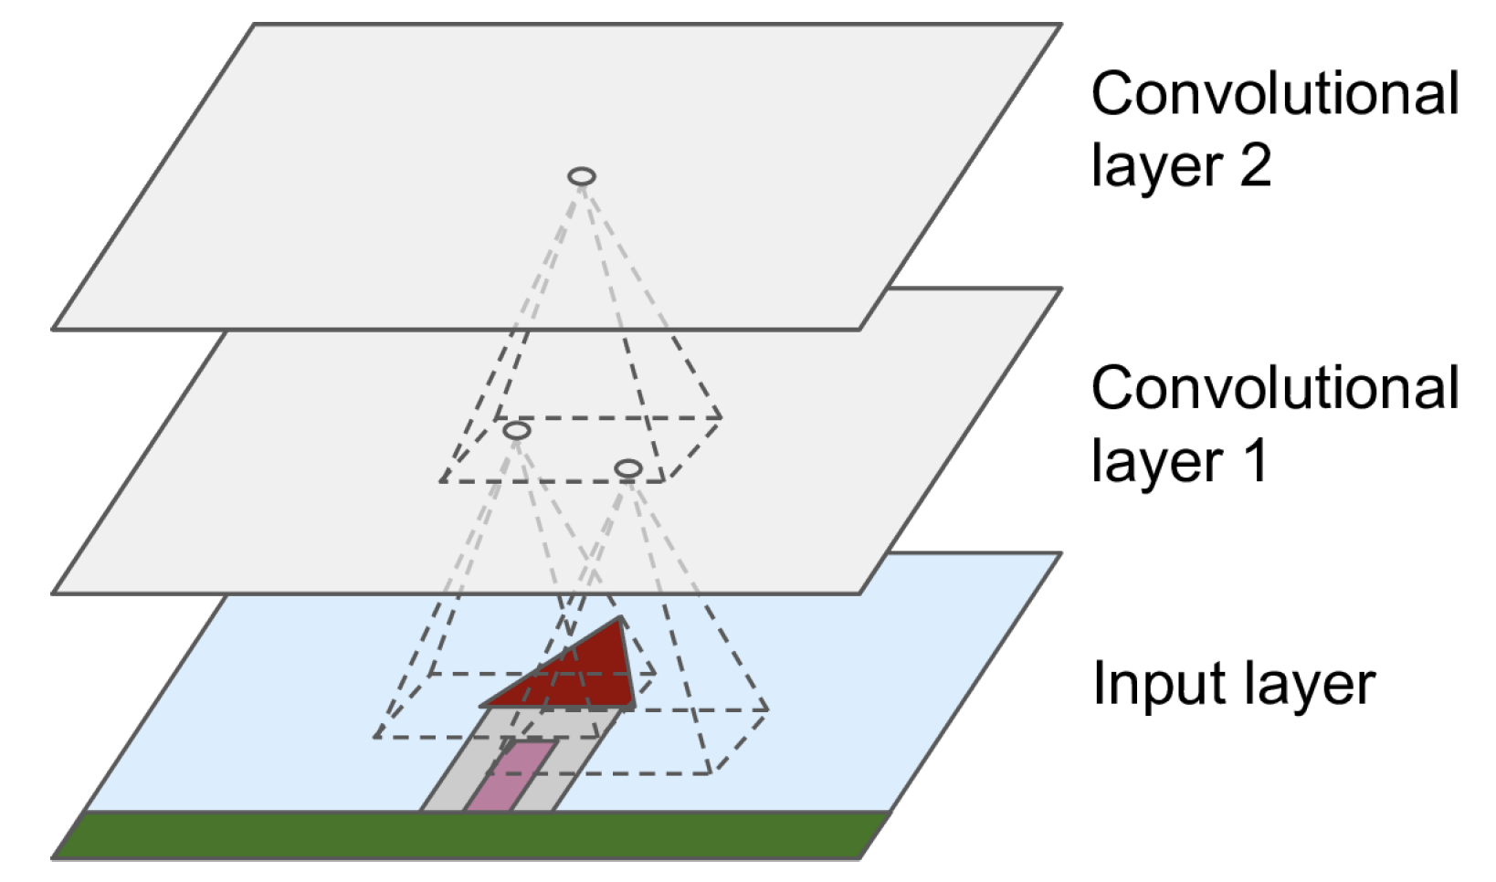
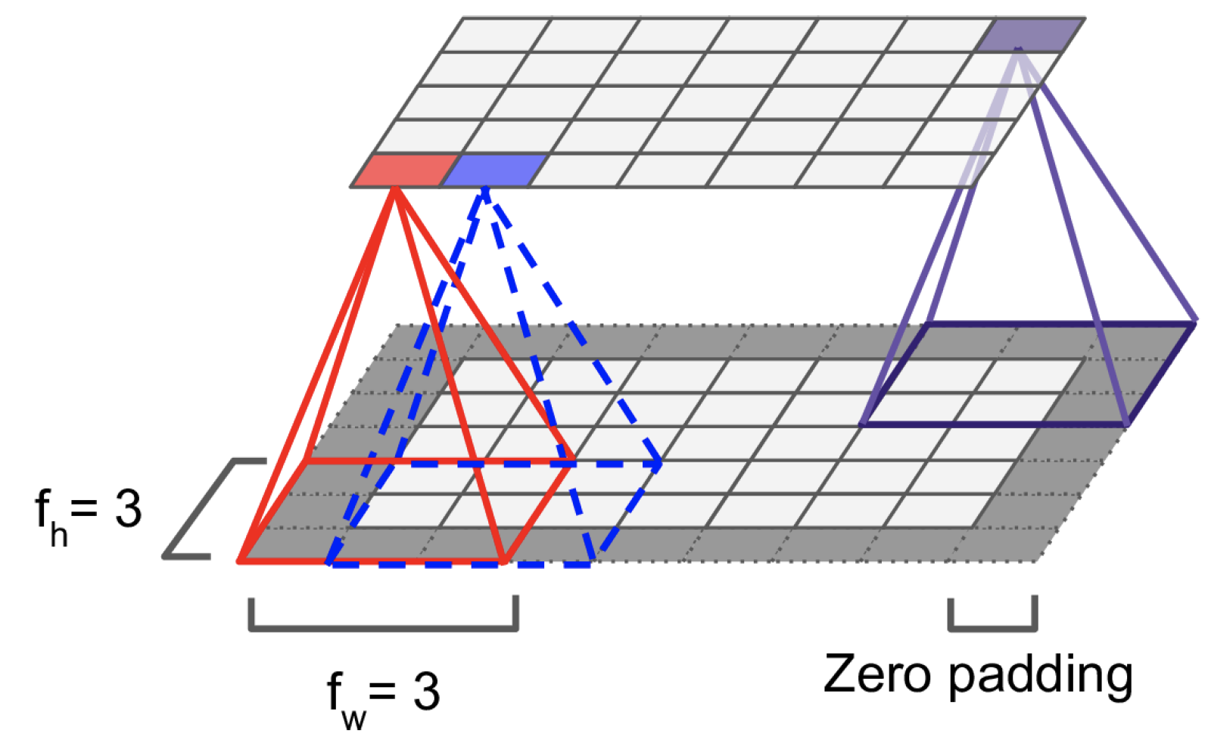
Day 09 Convolutional Layers
Neurons in the first convolutional layer are connected only to a small rectangle of pixels representing their receptive fields.
Each neuron in subsequent layers is connected to neurons located in their receptive field.
Each neuron layer is now 2D
f_{h} and f_{w} define the height and width of the receptive field.
Debora/Ayham (UWA)

Slide 59
Day 09 Convolution
Important operation in image processing.
A (small) kernel matrix is applied to the input image in order to get a transformed image according to a specific task.
Input matrix
Output matrix
95 | 101 | 98 | 102 | 97
96 | 100 | 99 | 101 | 114
99 | 98 | 99 | 99 | 87
94 | 98 | 100 | 102 | 94
89 | 91 | 95 | 98 | 89
100 | 99 | 87 | 89 | 91
104 | 101 | 88 | 93 | 96
Kernel matrix
 | 106
0 | -1 | 0
-1 | 5 | -1
0 | -1 | 0
Multiplication of each element of the kernel with the corresponding element of the image matrix.
(95 * 0) + (101 * -1) + (98 * 0)
+ (96 * -1) + (100 * 5) + (99 * -1)
+ (99 * 0) + (98 * -1) + (99 * 0) = 106

Slide 60
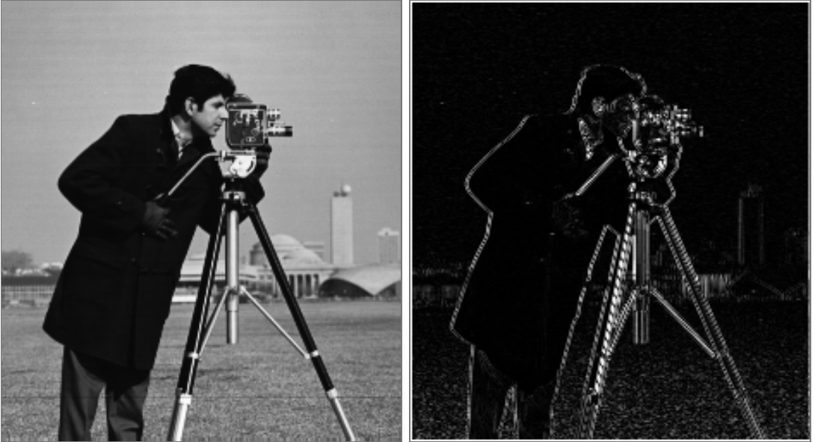
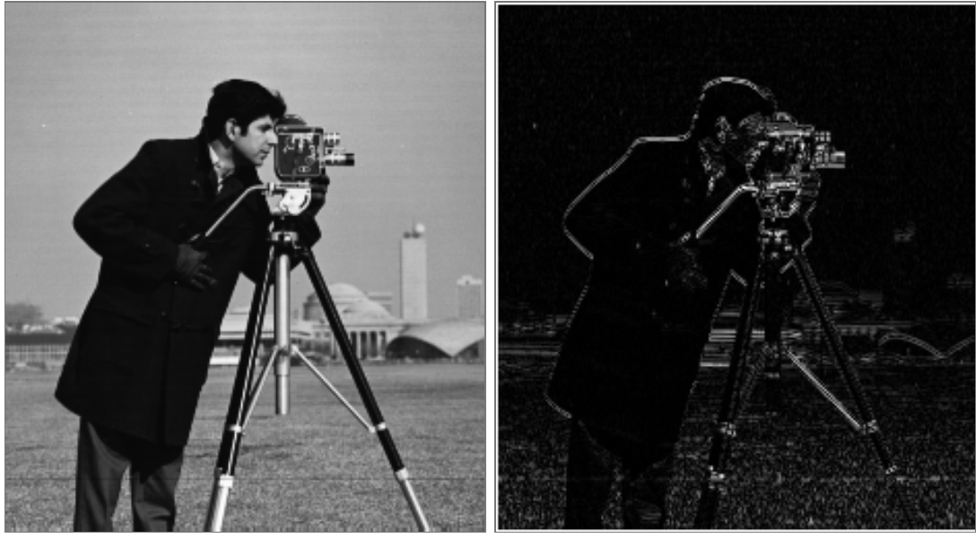
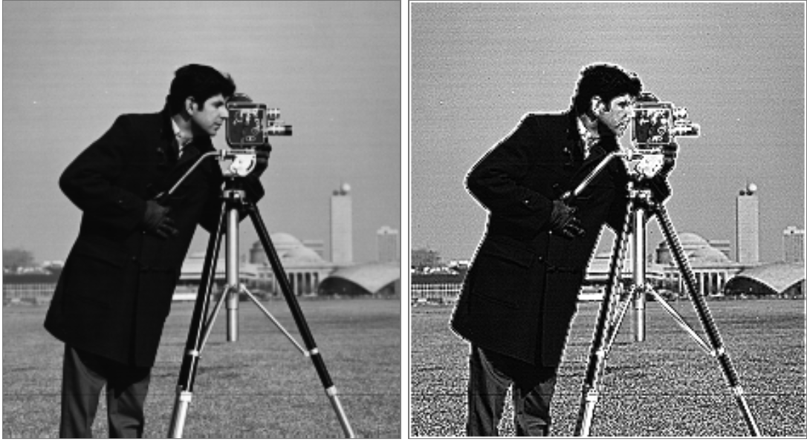
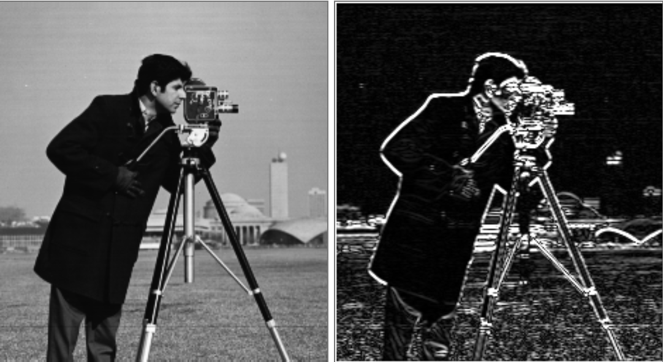
Day 09 Convolution (Cont.)
E.g., edge detection (horizontal, vertical), sharpen, blurring, etc.
0 | 0 | 0
-1 | 2 | -1
0 | 0 | 0
0 | -1 | 0
0 | 2 | 0
0 | -1 | 0
0 | -1 | 0
-1 | 5 | -1
0 | -1 | 0
1 | 2 | 1
0 | 0 | 0
-1 | -2 | -1

Slide 61

Day 09 RGB Images
Source: http://machinelearninguru.com

Slide 62
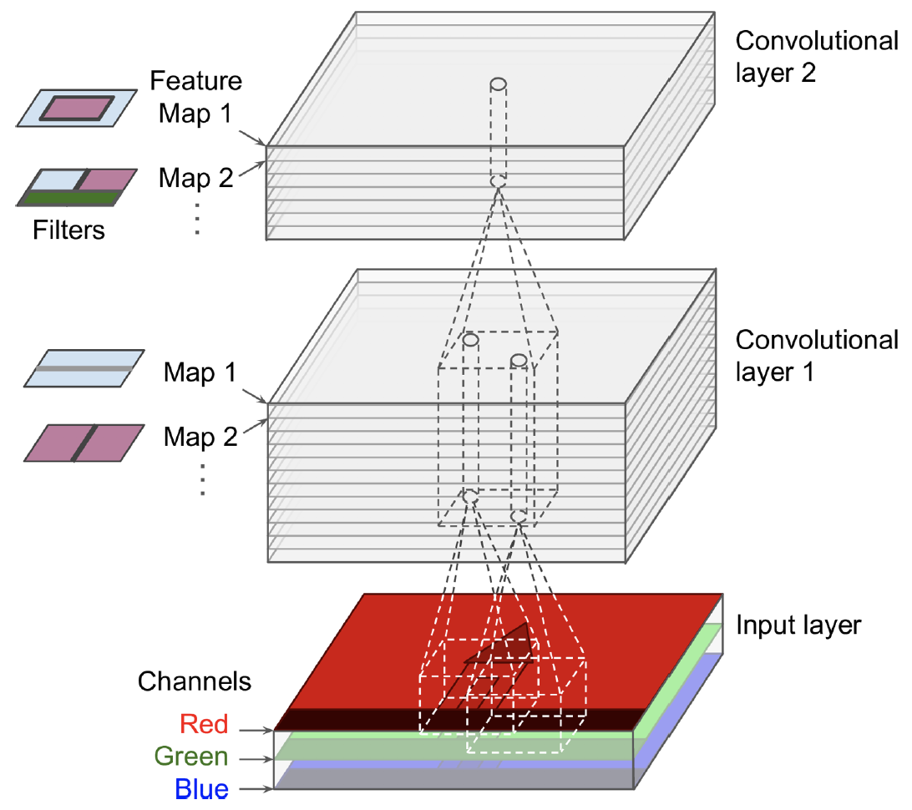
Day 09 Stacking Multiple Feature Maps
Kernel matrix
0 | -1 | 0
-1 | 5 | -1
0 | -1 | 0
The weights of the kernel and the bias of each feature map are trained with the back-propagation algorithm.
A feature map share the same weights and bias.
An activation function is applied after each convolutional layer.
Source: Hands on Machine Learning with Scikit-Learn and TensorFlow, Cap. 13.

Slide 63
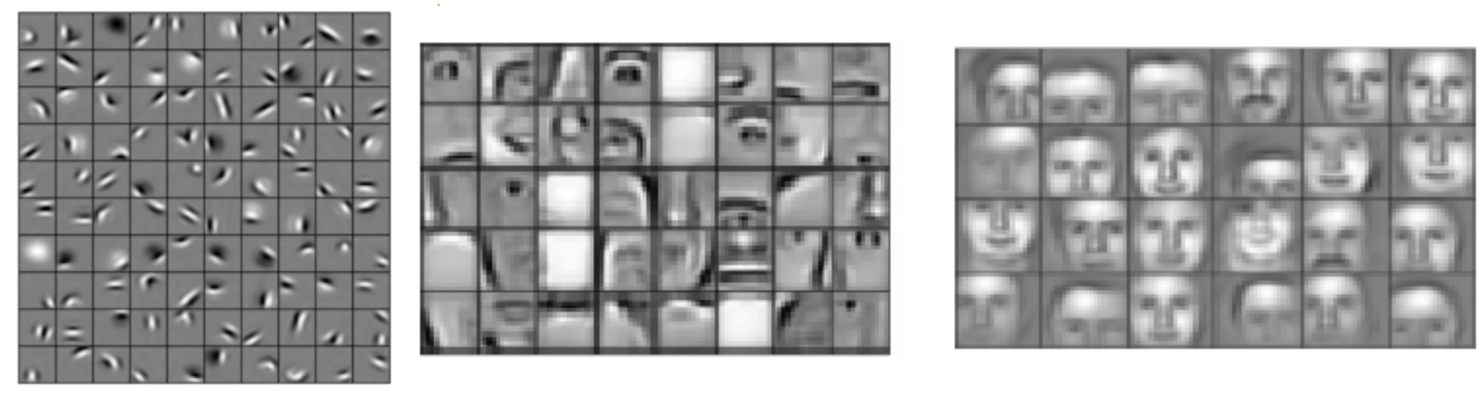
CNN - Intuition
Source: https://devblogs.nvidia.com/deep-learning-nutshell-core-concepts/

Slide 64
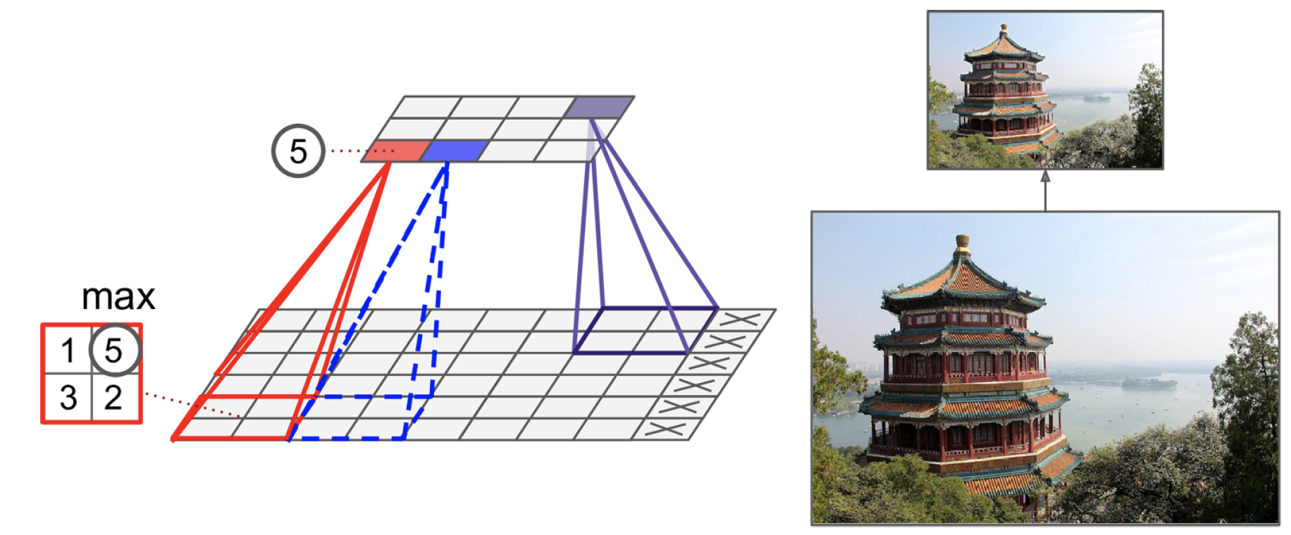
Day 09 Pooling layer
Idea: subsample the output of a layers.
Aggregation function, e.g., mean or max.
No weights, but requires the definition of size, stride, padding.
Debora/Ayham (UWA)

Slide 65
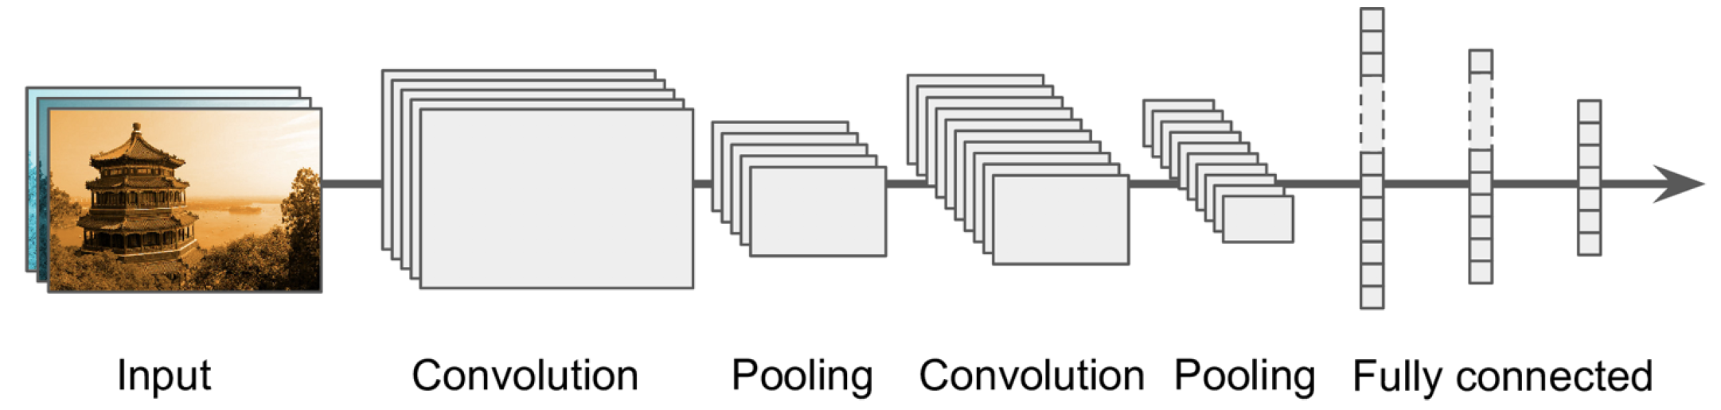
Day 09 CNN Architecture
The conventional convolutional neural network is formed by convolutional layers, pooling layers and fully connected layers (with activation functions).
Idea: Generate feature maps that contain relevant (discriminative) and compacted high-level features about the input image.
Final layer outputs the prediction of the class.

Slide 66
CNN vs Deep MLPs
CNNs propose partially connected layers
As all neurons in a feature map share the same weights and bias, CNN models significantly reduces the number of parameters of the model.
E.g., consider 100 x 100 images -> 10,000 pixels. A first MLP layer with 1,000 neurons (quite limited) requires 10 million parameters (just the first layer!).
Location and rotation invariance
CNNs learns a pattern independently of its location and 2D rotation.
Transfer learning.
Debora/Ayham(UWA)

Slide 67
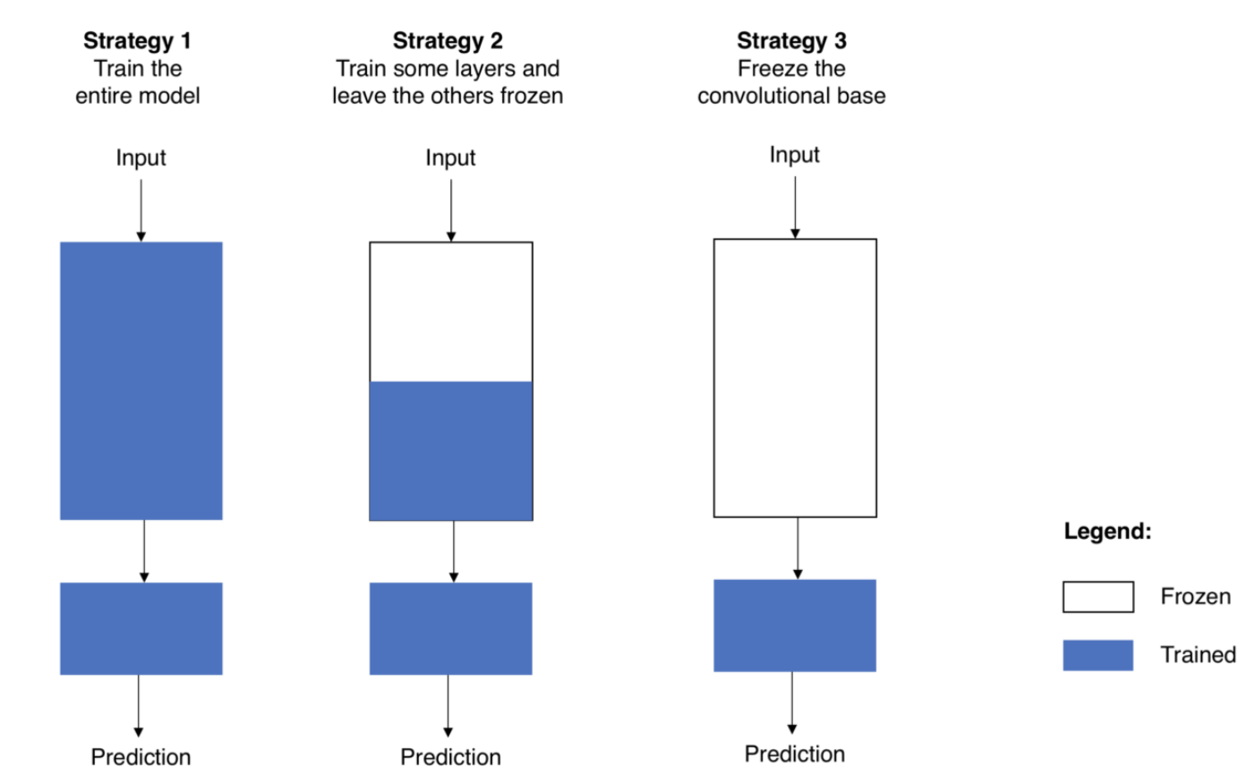
Day 09 Transfer Learning
Time efficient design of accurate deep learning models.
Idea: use of pre-trained models on tasks similar to what you want to solve.
Source: https://towardsdatascience.com/transfer-learning-from-pre-trained-models-f2393f124751
Debora/Ayham (UWA)
Notes:
67

Slide 68
Day 09 Powerful architectures
Variants of the fundamental architecture used for transfer learning.
InceptionV4
https://arxiv.org/pdf/1602.07261.pdf
VGG
http://www.robots.ox.ac.uk/~vgg/practicals/cnn/index.html
GoogLeNet
https://ai.google/research/pubs/pub43022
ResNet
https://www.cv-foundation.org/openaccess/content_cvpr_2016/html/He_Deep_Residual_Learning_CVPR_2016_paper.html

Slide 69
Day 9 Recurrent Neural Networks (RNNs)

Slide 70
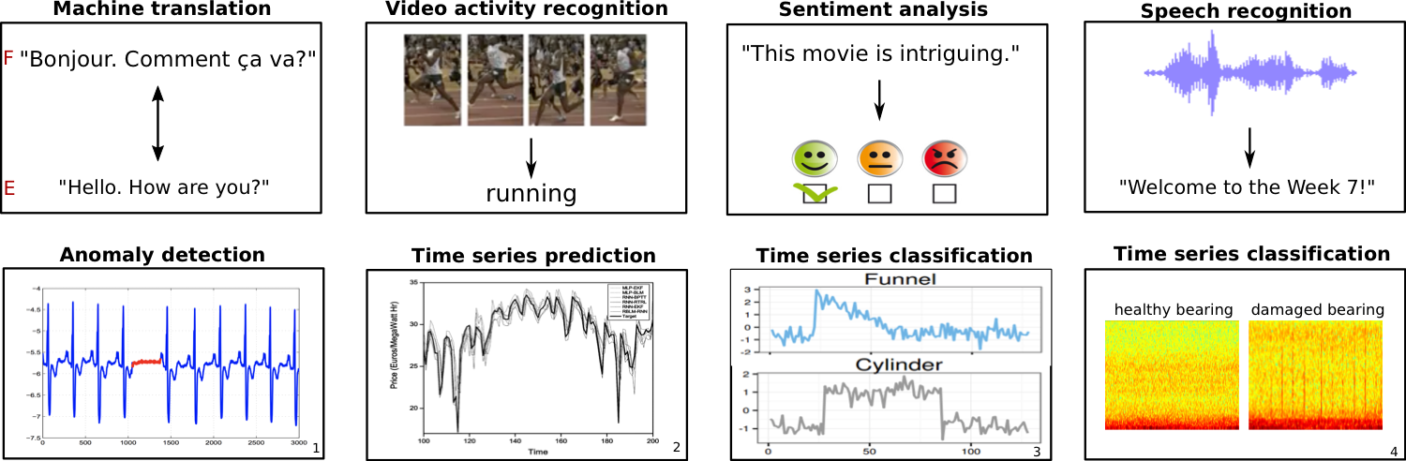
Sequence models
When to use sequence models?
Temporal dynamics connecting data samples are important.
Context is important: past samples or decisions influence current predictions.
Share features across different positions of the data is important.
1 - ChandolaV, Banerjee A, Kumar V. Anomaly detection: A survey. ACM computing surveys (CSUR). 2009 Jul 1;41(3):15.
2 - MirikitaniDT, NikolaevN. Recursive bayesianrecurrent neural networks for time-series modeling. IEEE Transactions on Neural Networks. 2010 Feb;21(2):262-74.
3 - https://cs.gmu.edu/~xwang24/Projects/RPM.html
4 - Zak, G, et al. Application of ARMA modelling and alpha-stable distribution for local damage detection in bearings, Diagnostyka,2014.
Débora/Ayham (UWA)

Slide 71
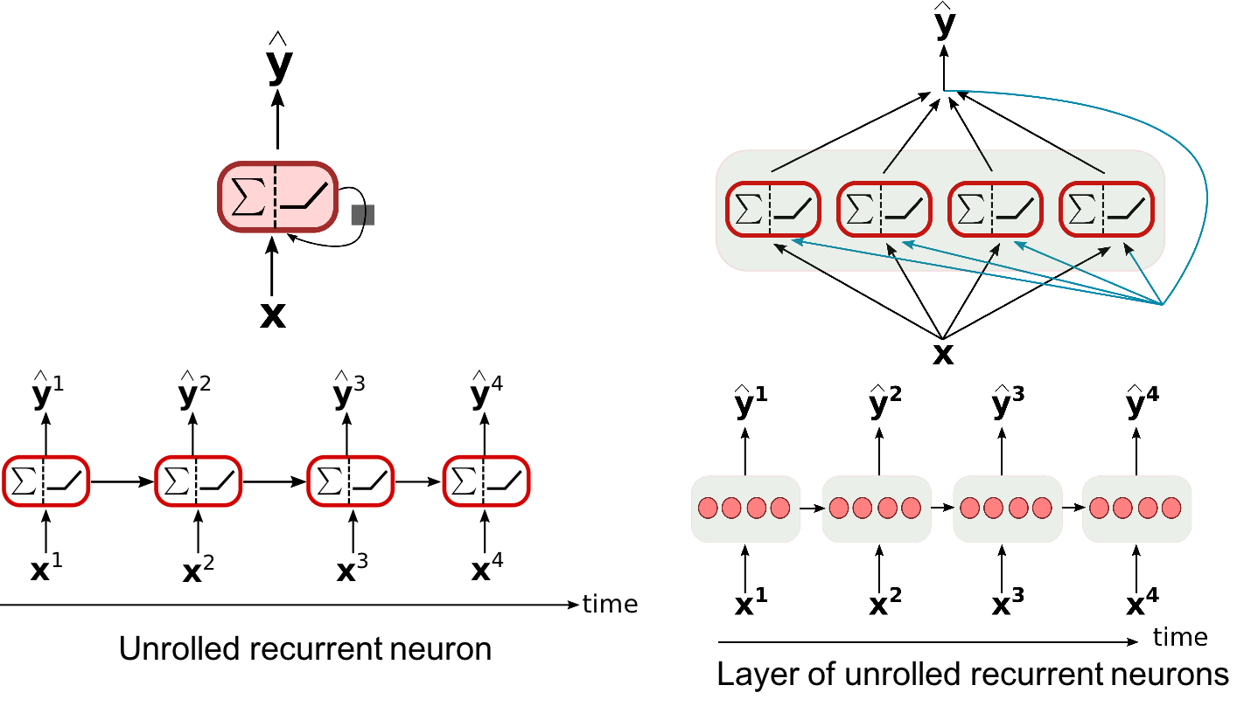
The Recurrent Neural Network Model
Similar to their feedforward counterpart, but including loop connections, allowing information to persist.
Débora/Ayham (UWA)
Source: Hands on Machine Learning with Scikit-Learn and TensorFlow,Cap. 14.

Slide 72
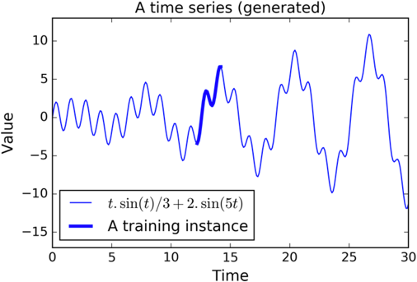
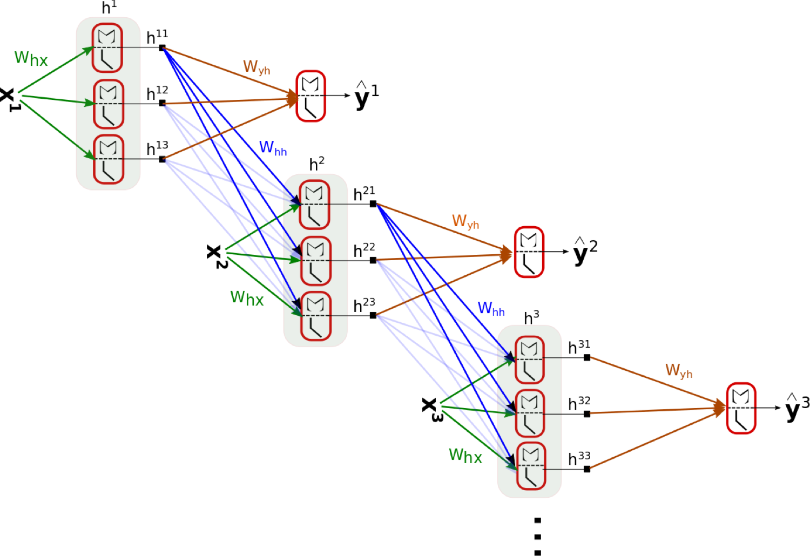
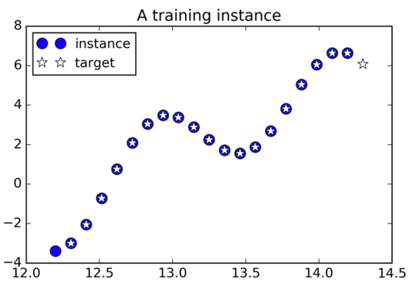
The RNN computations
Débora/Ayham (UWA)
Source: Hands on Machine Learning with Scikit-Learn and TensorFlow,Cap. 14.

Slide 73
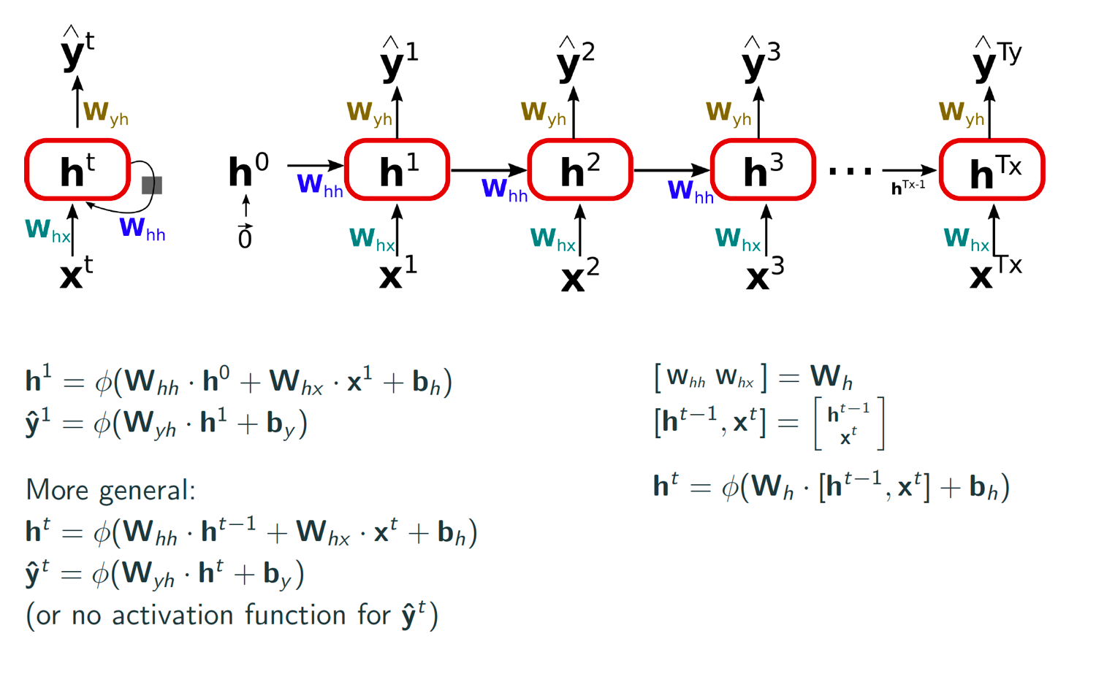
The RNN computations
Débora/Ayham (UWA)
Source: Hands on Machine Learning with Scikit-Learn and TensorFlow,Cap. 14.

Slide 74
Backpropagation through time
Forward pass: Training instances are fed to the network and output are computed.
Backward pass: Measures the error gradients (in all time steps) with respect to all parameters in the network by (back)propagating the error gradient.
Débora/Ayham (UWA)
Source: P. J. Werbos, 1990. Backpropagation through time: what it does and how to do it

Slide 75
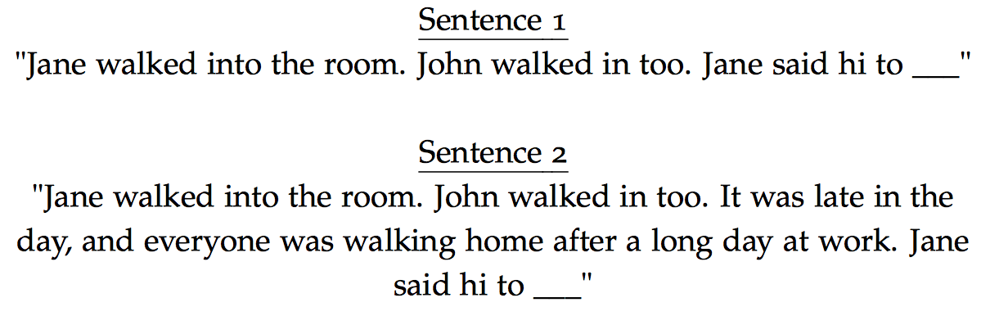
Vanishing Gradients
A basic RNN algorithm very often runs into vanishing gradient problems.
To train it on long sequences, many time steps make the unrolled RNN similar to a very deep network.
The gradients get smaller and smaller as GD goes down to the lower layers - for which connection weights remain practically unchanged.
Pascanuet al., 2013. On the difficulty of training recurrent neural networks.
Sentence examples from https://cs224d.stanford.edu/lecture_notes/LectureNotes4.pdf.
Débora/Ayham (UWA)

Slide 76

Advanced RNNs
Débora/Ayham (UWA)

Slide 77

Advanced RNNs – Long Short-term Memory (LSTM)
The LSTM cell learns long-term dependencies in the data, and training usually converge faster than with the basic RNNs.
S. Hochreiterand J. Schmidhuber, 1997. Long Short-term Memory.
Gers et al., 1999. Learning to forget: continual prediction with LSTM.
http://colah.github.io/posts/2015-08-Understanding-LSTMs
Débora/Ayham (UWA)

Slide 78

Advanced RNNs – LSTM forward pass
The cell state c^{t} is the important aspect of the LSTM: it flows the information related to long-term memories.
The short-term state h^{t} works similar as the basic RNN cell, and its output goes directly to y^{t}.
Variants and improvements:
F.A. Gers and J. Schmidhuber, 2000. Recurrentnets that time and count.
Gers et al., 2002, Learning Precise Timing with LSTM Recurrent Networks.
Zarembaet al., 2015, Recurrent Neural Network Regularization.
Débora/Ayham (UWA)

Slide 79


Advanced RNNs – Gated Recurrent Unit (GRU) cell
The GRU cell is a simpler (but effective) variant of the LSTM cell.
GRU and LSTM cells have showed similar results for many tasks.
Cho et al., 2014. Learning Phrase Representations using RNN Encoder–Decoder for Statistical Machine Translation.
Cho et al., 2014. On the Properties of Neural Machine Translation: Encoder - Decoder Approaches.
Chung et al., 2014. Empirical evaluation of gated recurrent neural networks on sequence modeling.
Greffet al., 2015. LSTM: A Search Space Odyssey.
Jozefowiczet al., 2015. An Empirical Exploration of Recurrent Network Architectures.
Débora/Ayham (UWA)

Slide 80

Types of RNN
Débora/Ayham (UWA)

Slide 81
Discussion
What are ANNs possible applications in industry?
Débora/Ayham (UWA)

Slide 82
Discussion
What are ANNs possible applications in industry?
Use of satellite images (remote sensing) to map the impacts to the environments of mining actives. Aim: identify locations which require attention in order to prevent extreme impact and fine from the government.
Real-time analysis of components in a haul truck for predictive analysis, for instance, to identify whether this component is getting extreme heating when in operation.
Given images from minerals, identify the quality of such materials.
Identification of high risk areas for slips, trips and falls in order to assist with workers' security.
Preventive analysis of fires in underground mines.
Prediction of sky clearness and solar radiations for solar energy applications.
Forecast of electrical energy consumption.
Débora/Ayham (UWA)

Slide 83




Day 09 Suggested references
Scikit-learn: http://scikit-learn.org
TensorFlow: https://www.tensorflow.org
Andrew Ng deep learning page: https://www.deeplearning.ai
Debora/Ayham (UWA)

